Slide 1
Curse of dimensionality
The Curse of Dimensionality is a paradox that data scientists face quite frequently. You want to use more information in order to improve the accuracy of your machine learning model, but the more features you add, the number of dimensions (n) increases.
As the dimensionality of the feature space increases, the number of configurations increases exponentially,.
Our ultimate goal as data scientists is to create simple models that can run quickly and are easy to explain.
When we have a large amount of features, our model becomes more complex and the explainability decreases. To deal with these complicated datasets,
Principal Component Analysis is an ideal method to reduce the dimensions of your data.

Slide 2
What is Principal Component Analysis
Principal Component Analysis, or more commonly known as PCA, is a way to reduce the number of variables while maintaining the majority of the important information.
It transforms a number of variables that may be correlated into a smaller number of uncorrelated variables, known as principal components.
The principal components are linear combinations of the original variables weighted by their variances (or eigenvalues) in a particular orthogonal dimension.
Using PCA also reduces the chance of overfitting your model by eliminating features with high correlation.
It is important to note that you should only apply PCA to continuous variables, not categorical. Although technically you can use PCA on one-hot encoded or otherwise binary data, it does not work very well. Why?

Slide 3
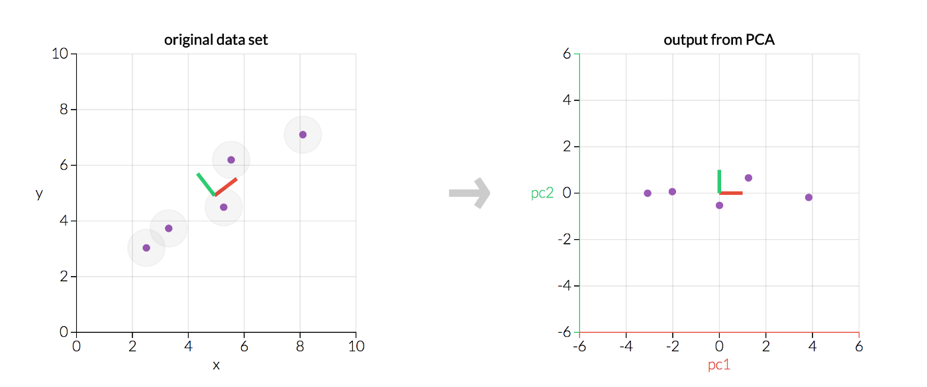

Slide 4
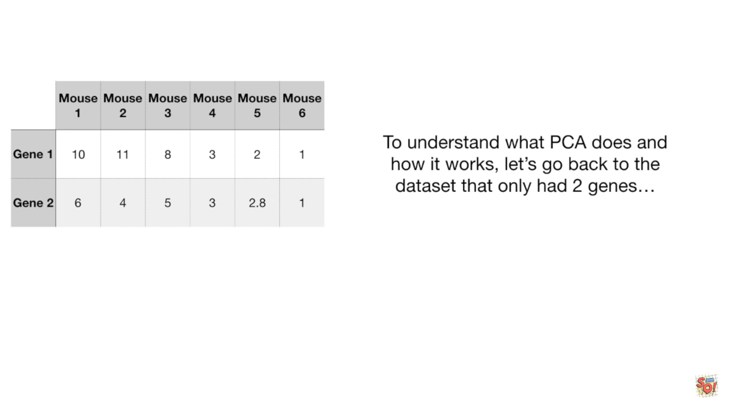

Slide 5
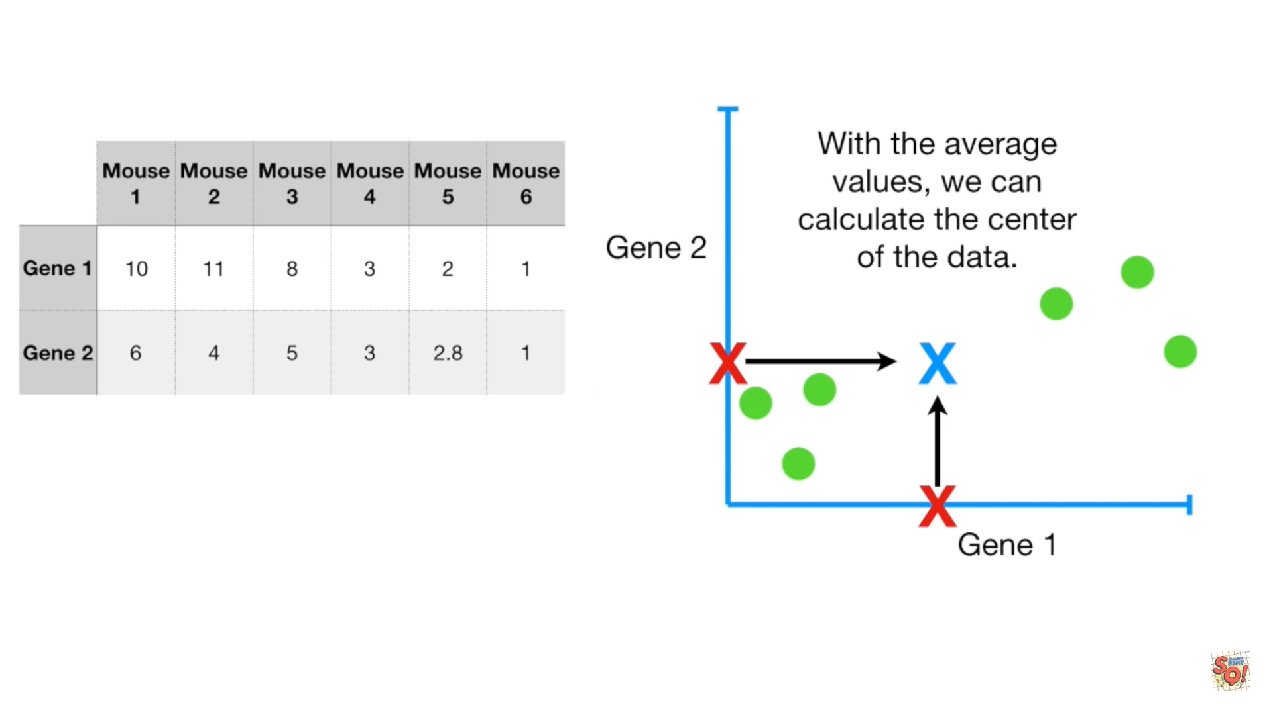

Slide 6
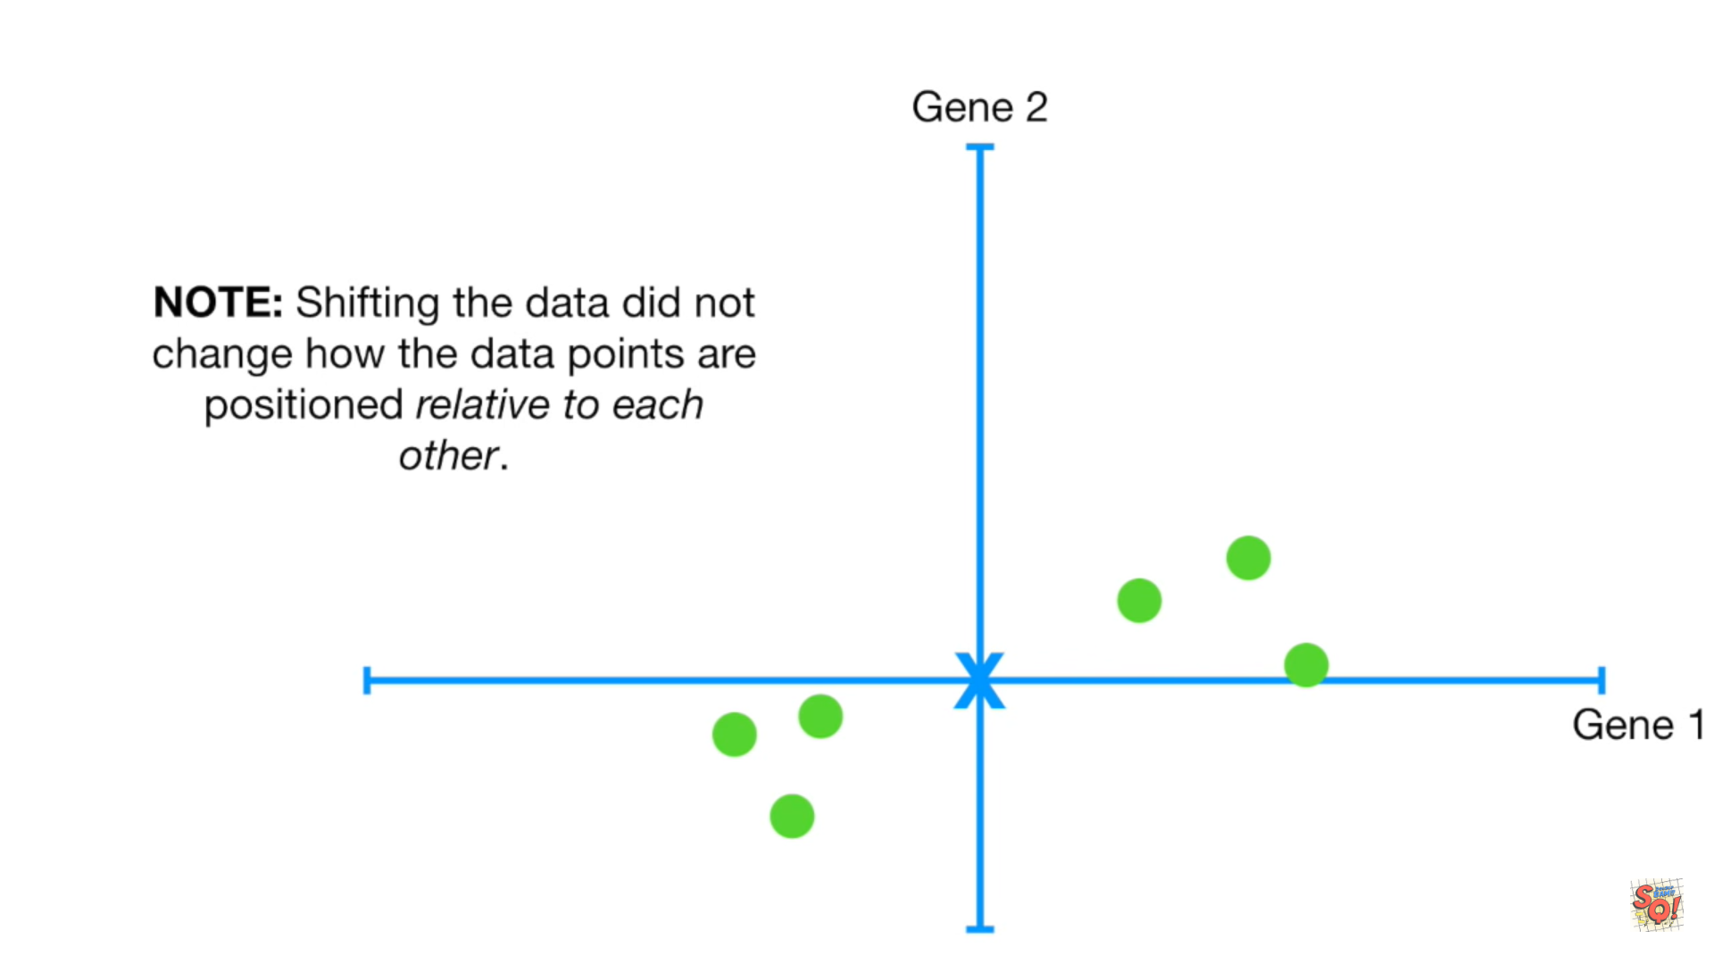

Slide 7
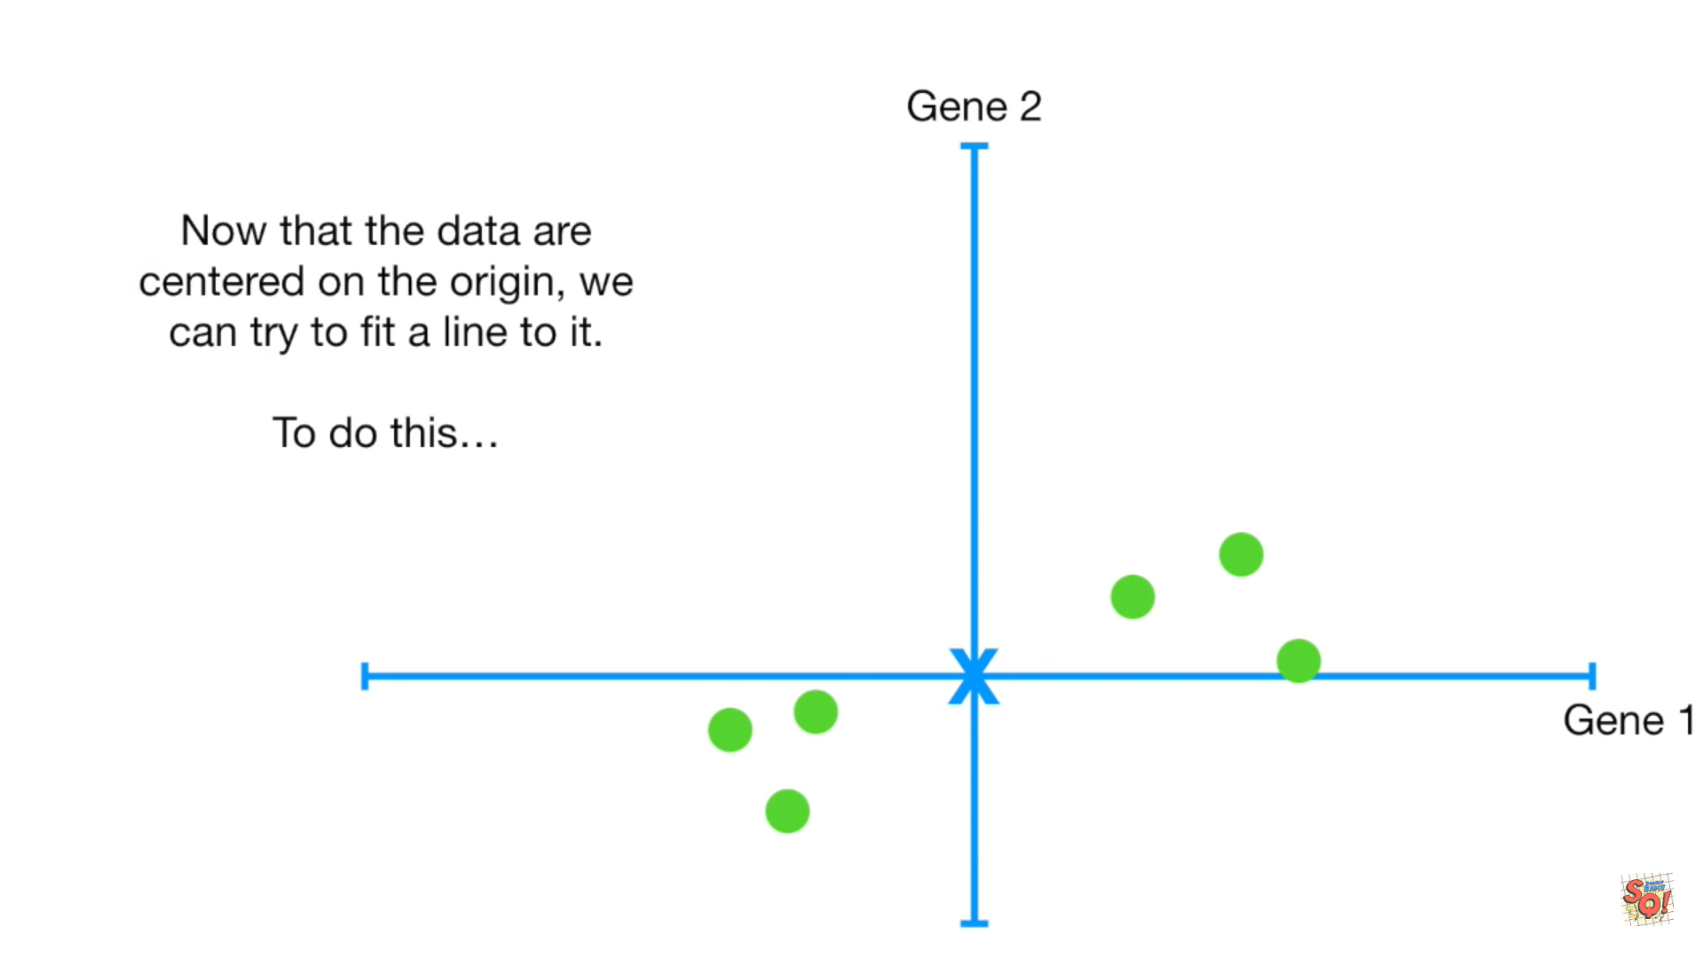

Slide 8


Slide 9
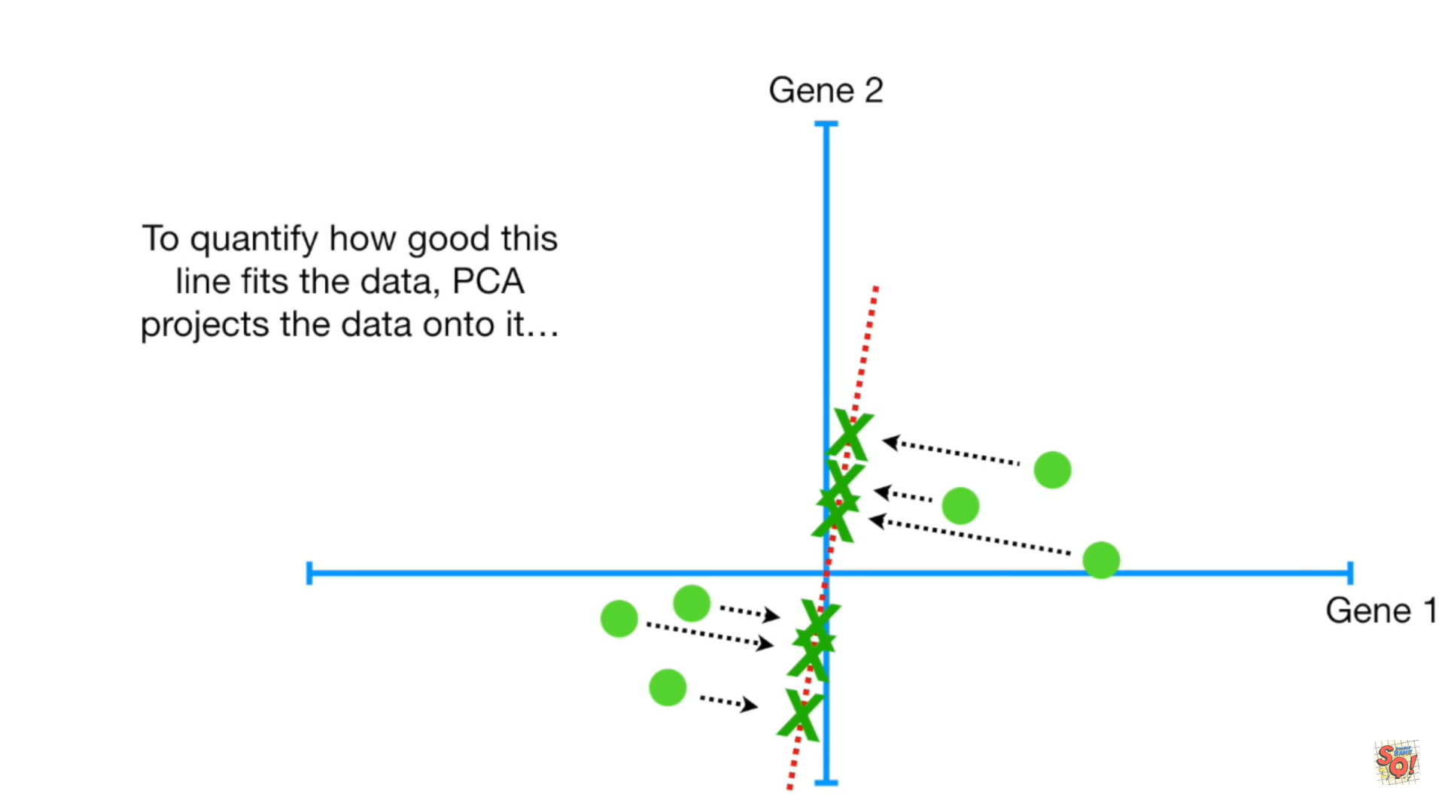

Slide 10
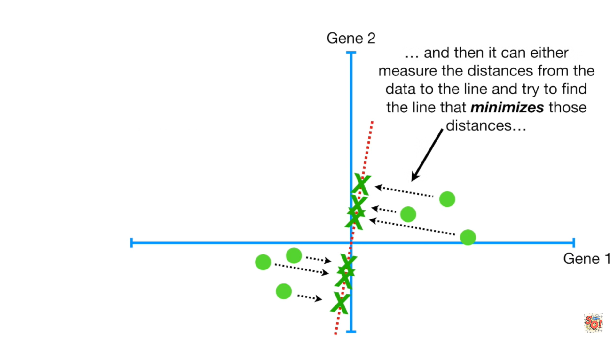

Slide 11
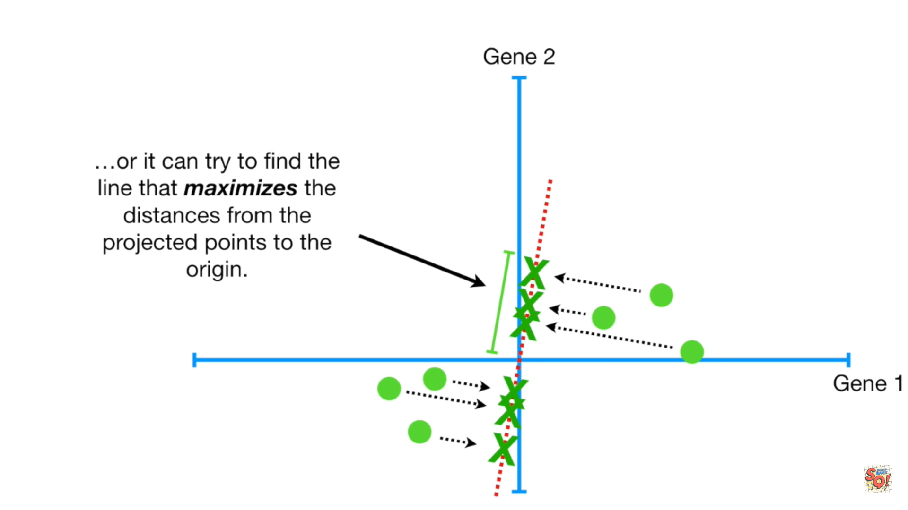

Slide 14
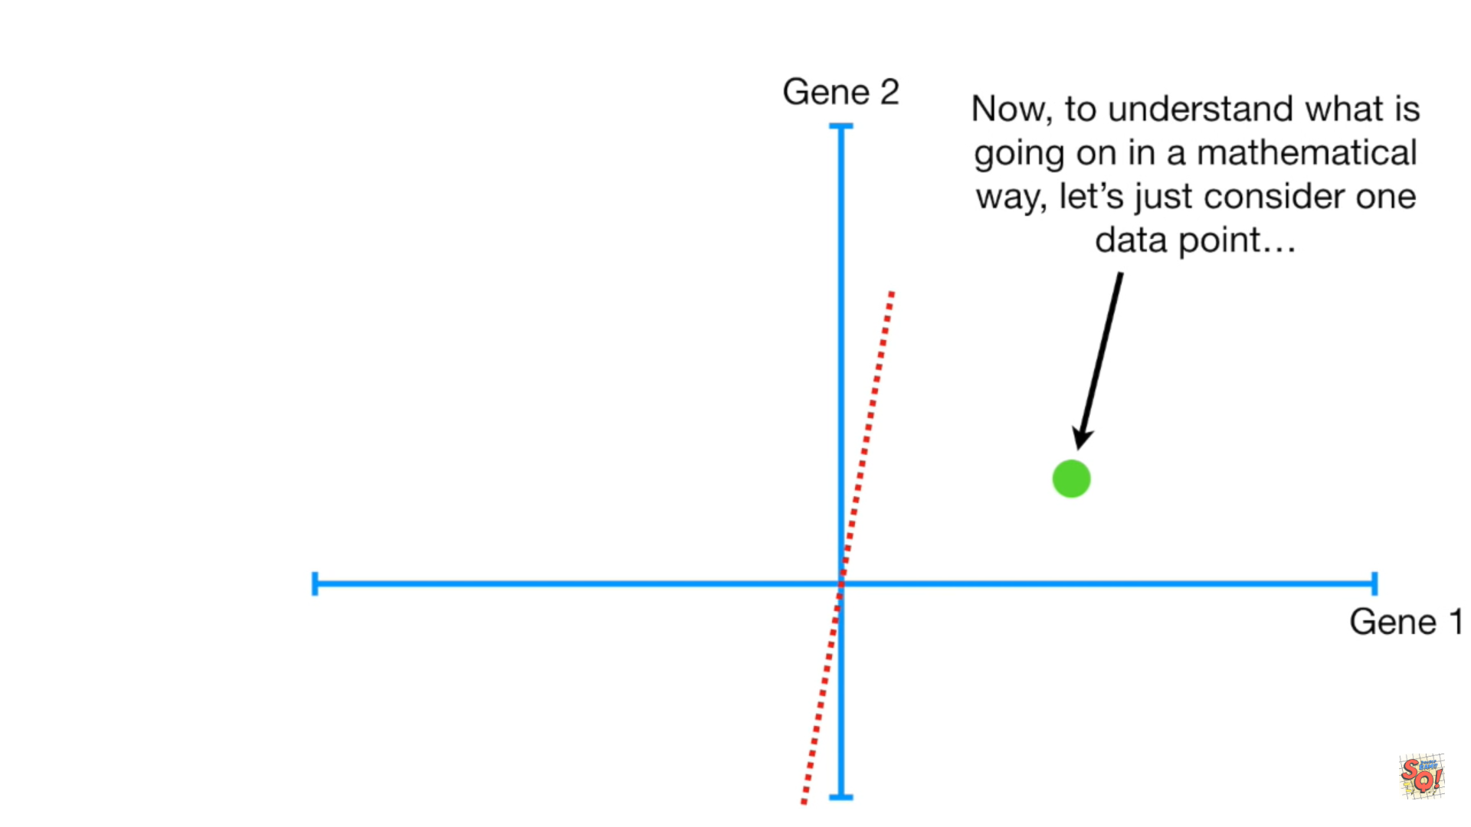

Slide 15
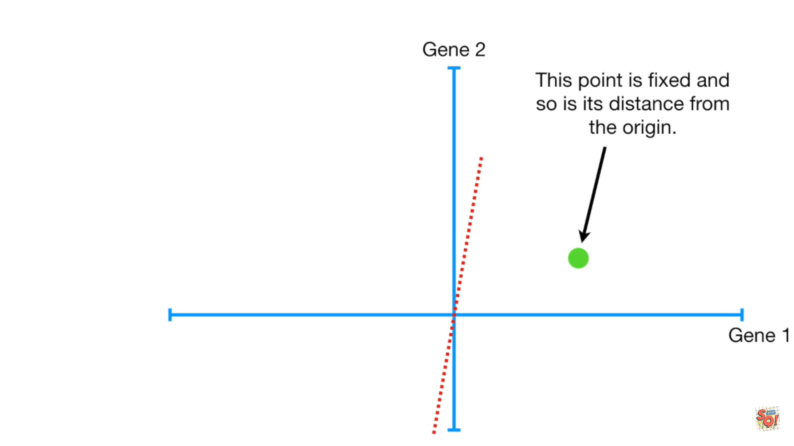

Slide 16
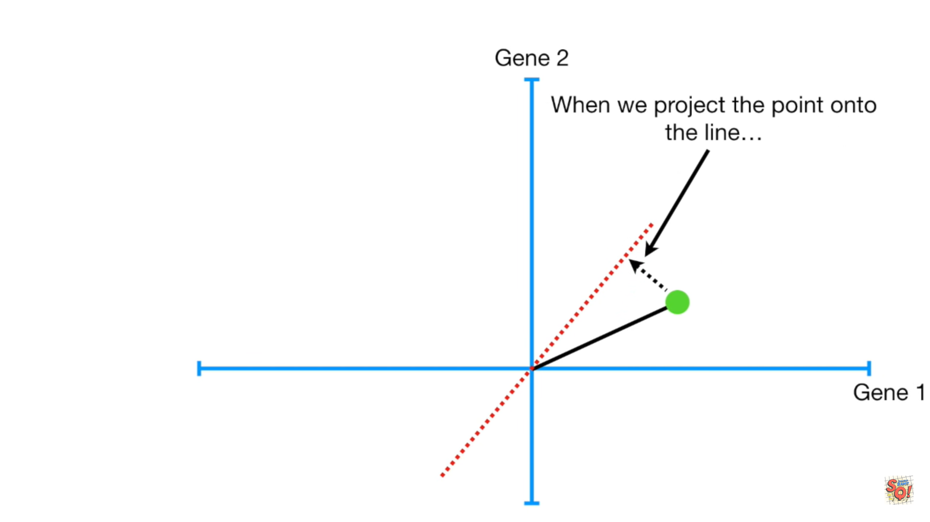

Slide 17
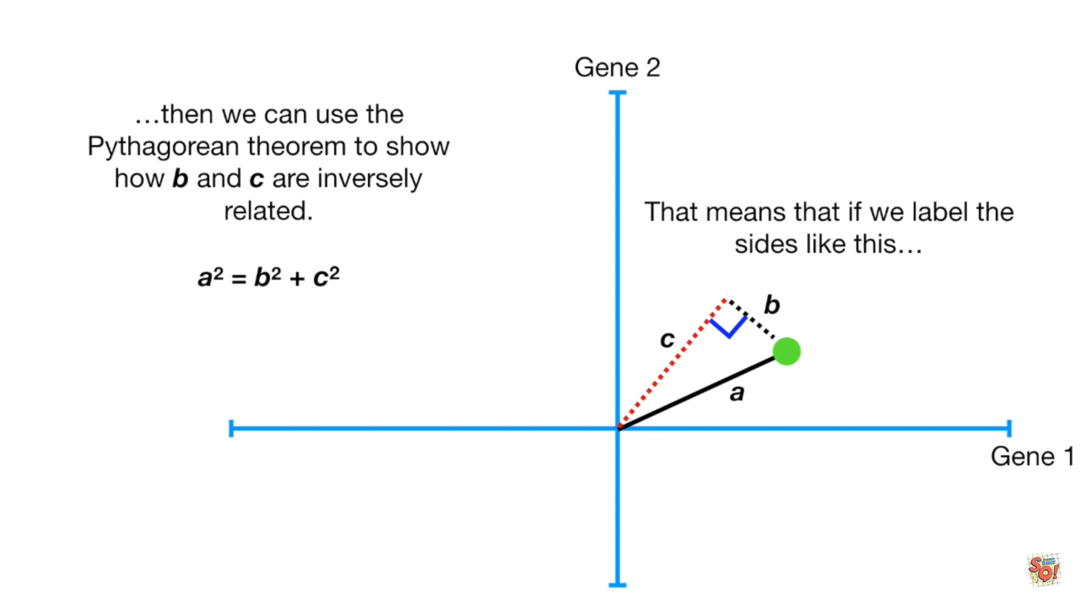

Slide 18
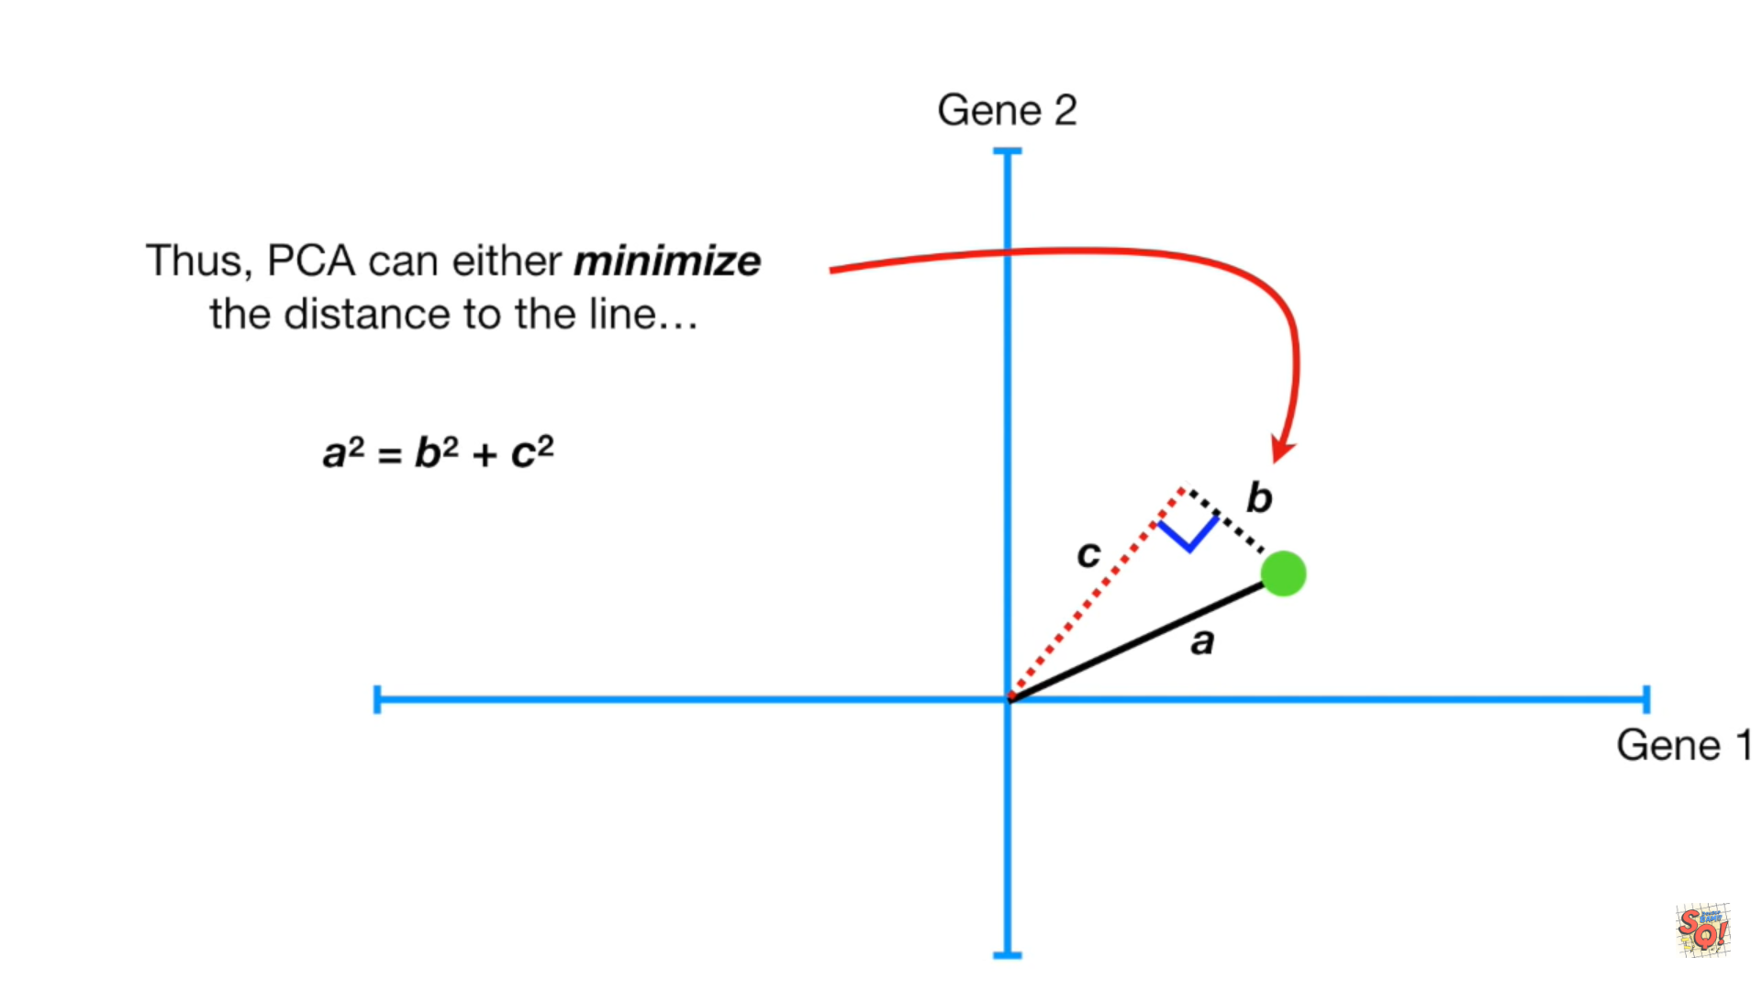

Slide 20
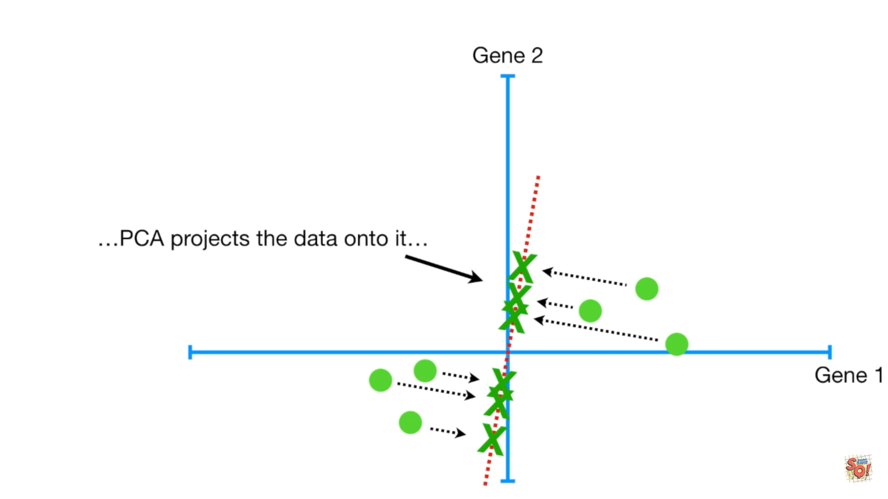

Slide 21
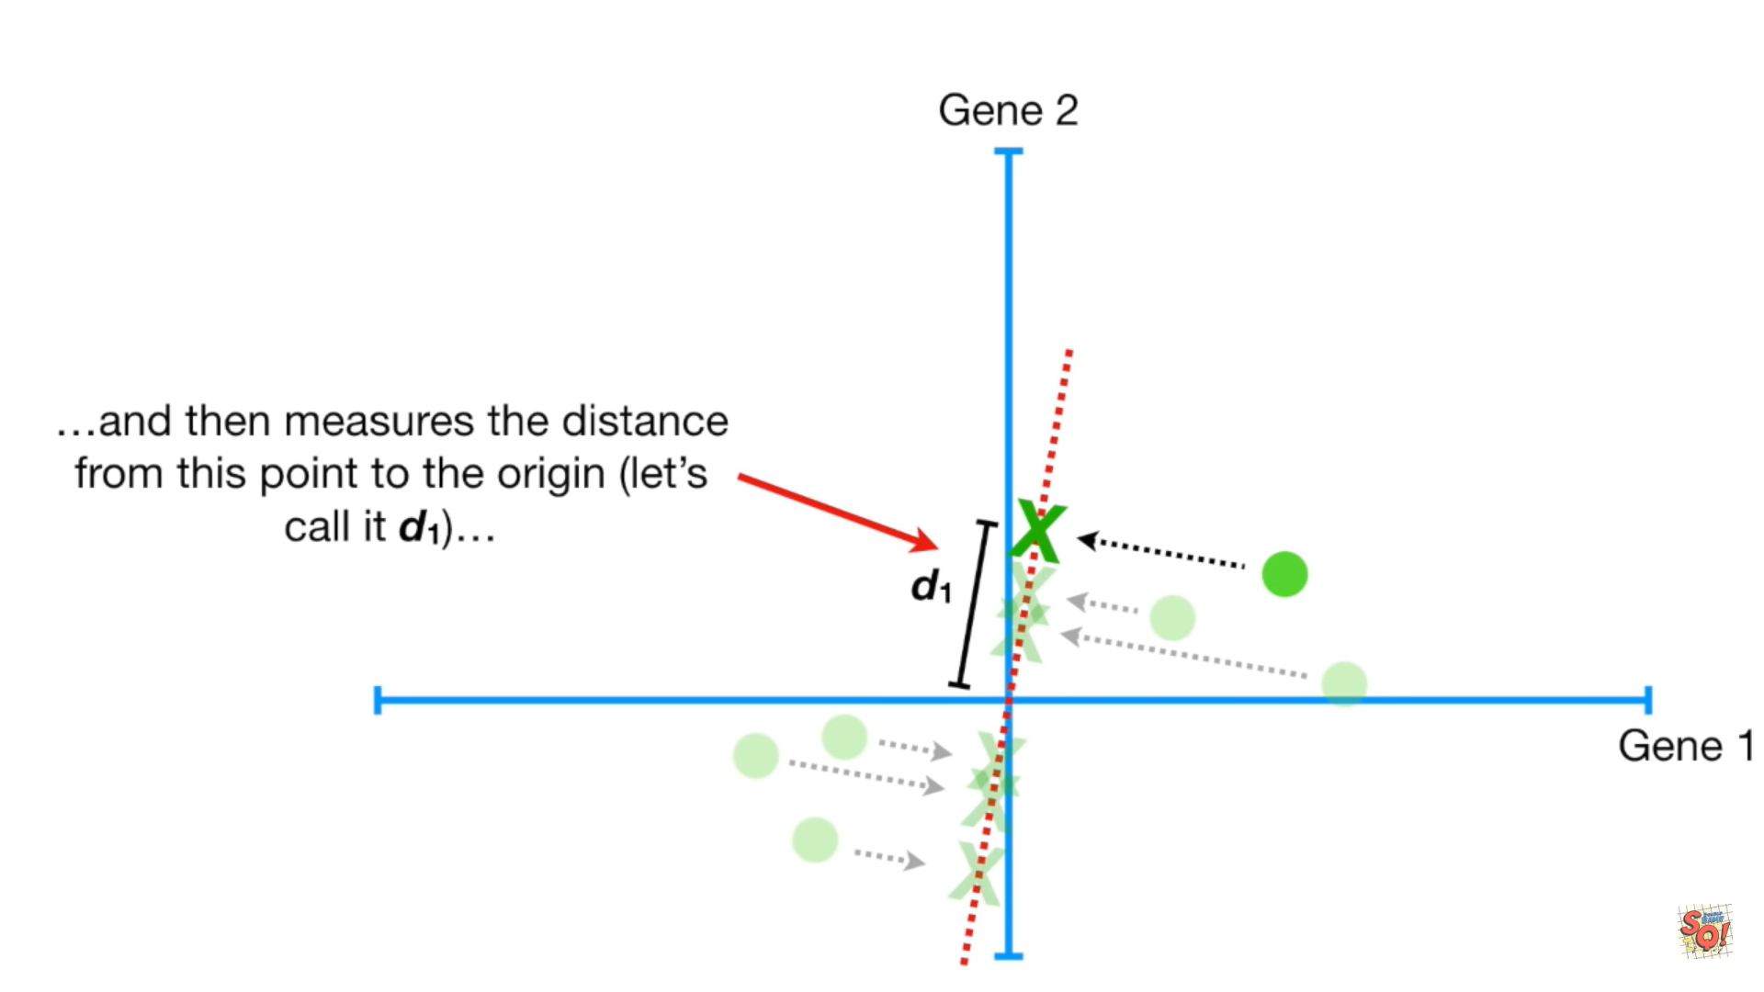

Slide 22
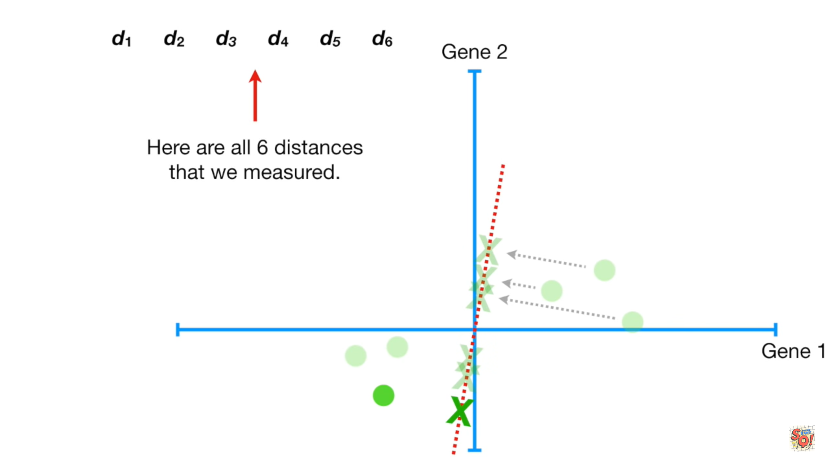

Slide 23
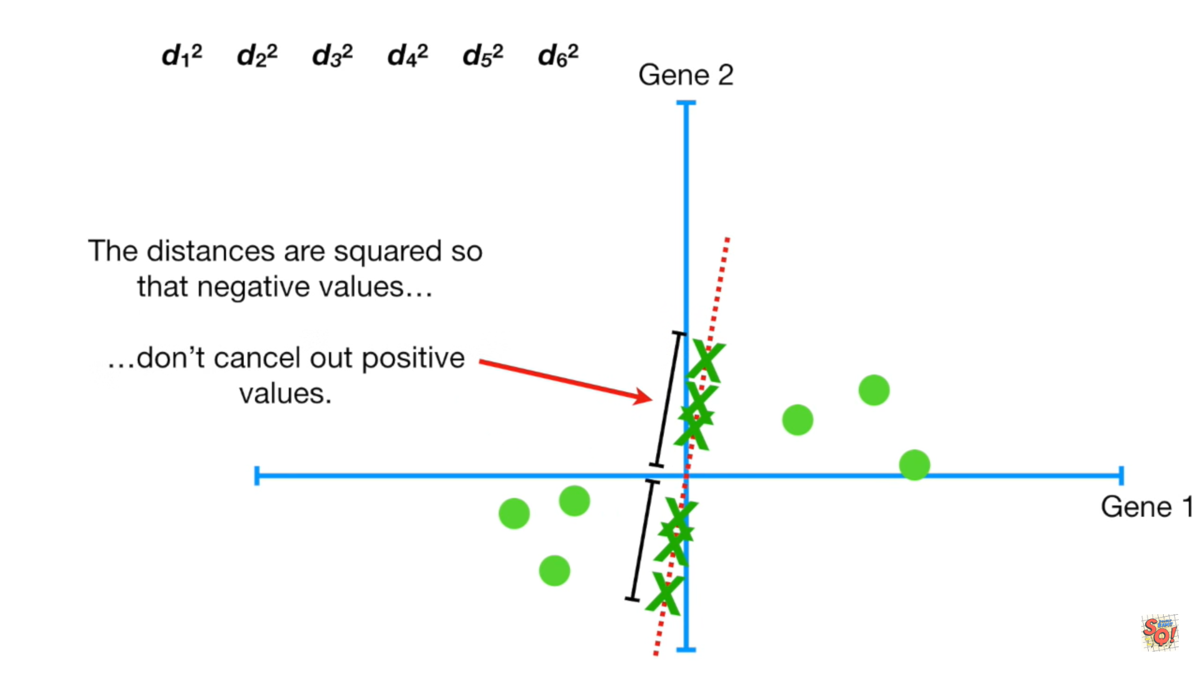

Slide 24
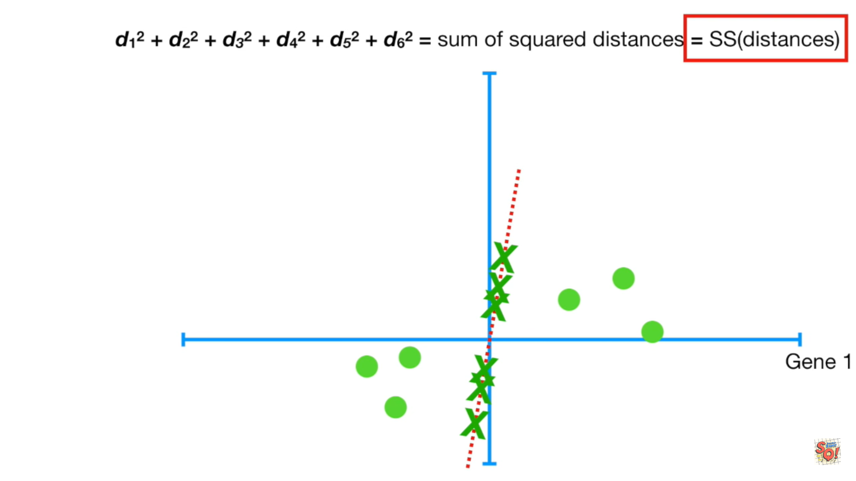

Slide 25
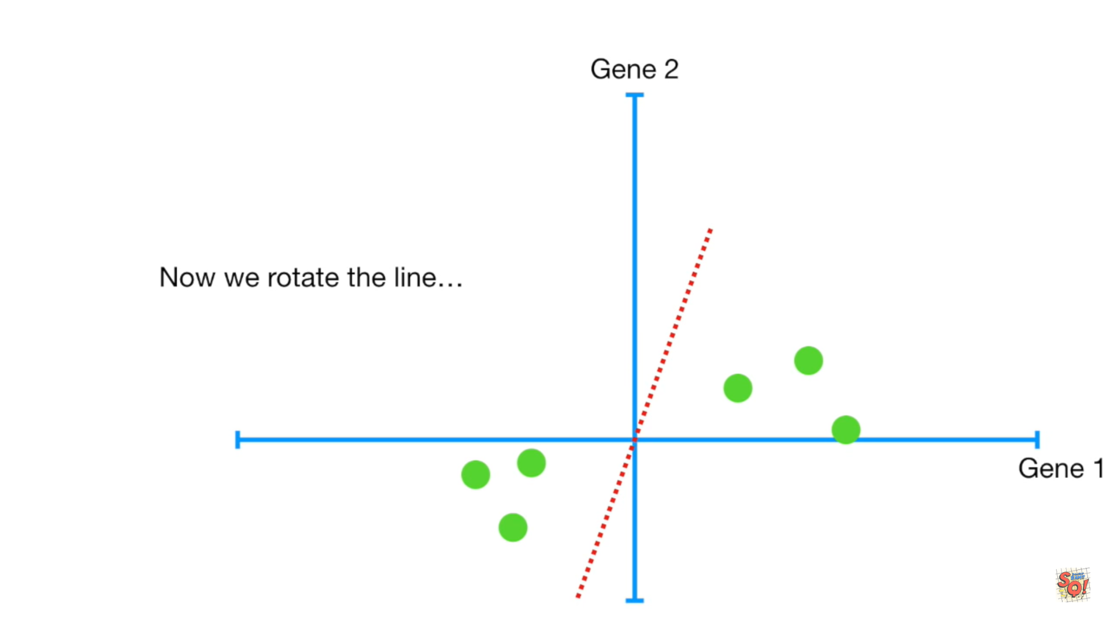

Slide 26
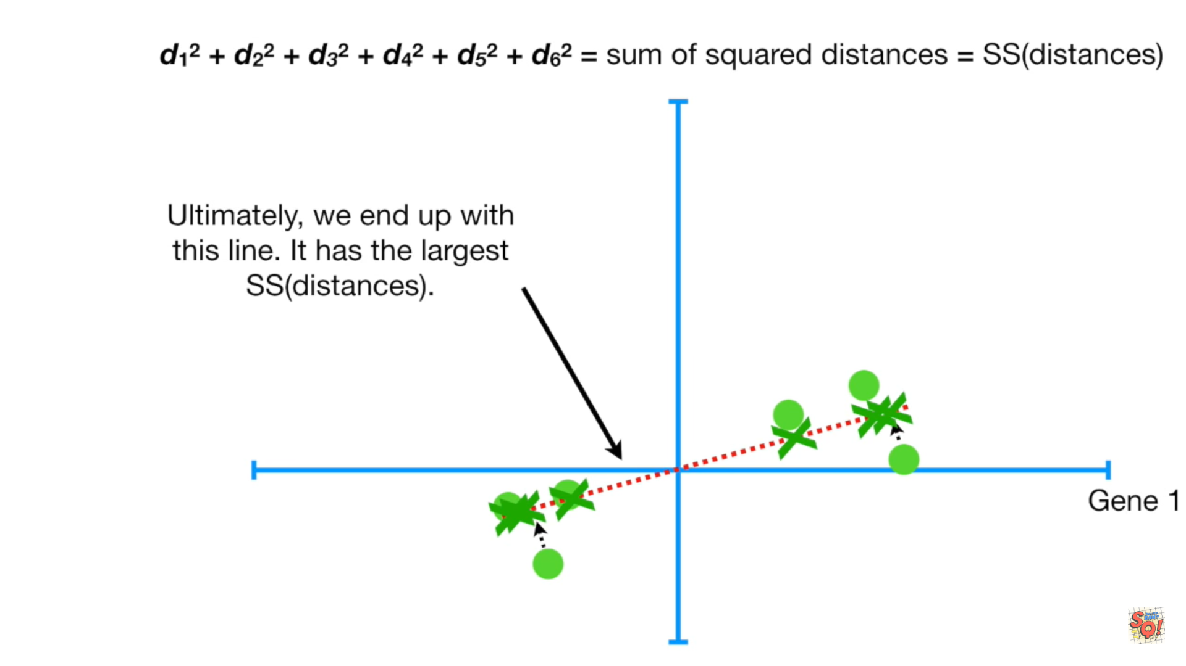

Slide 27
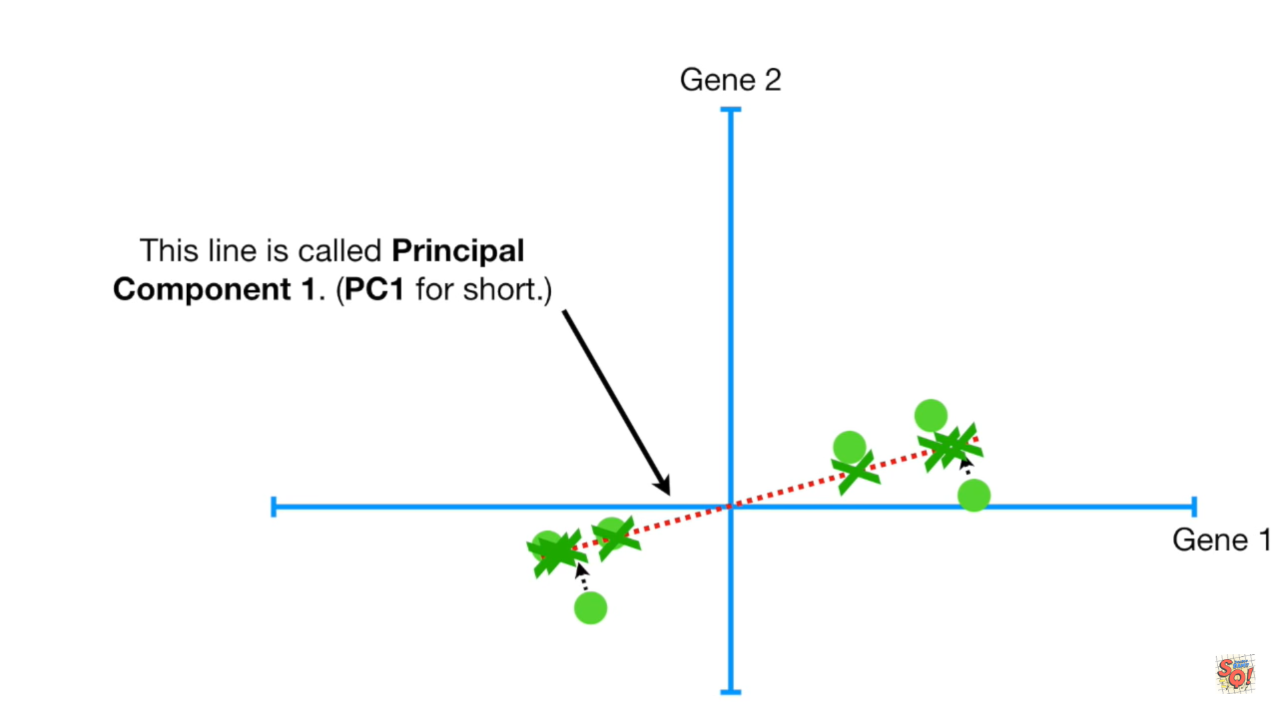

Slide 29
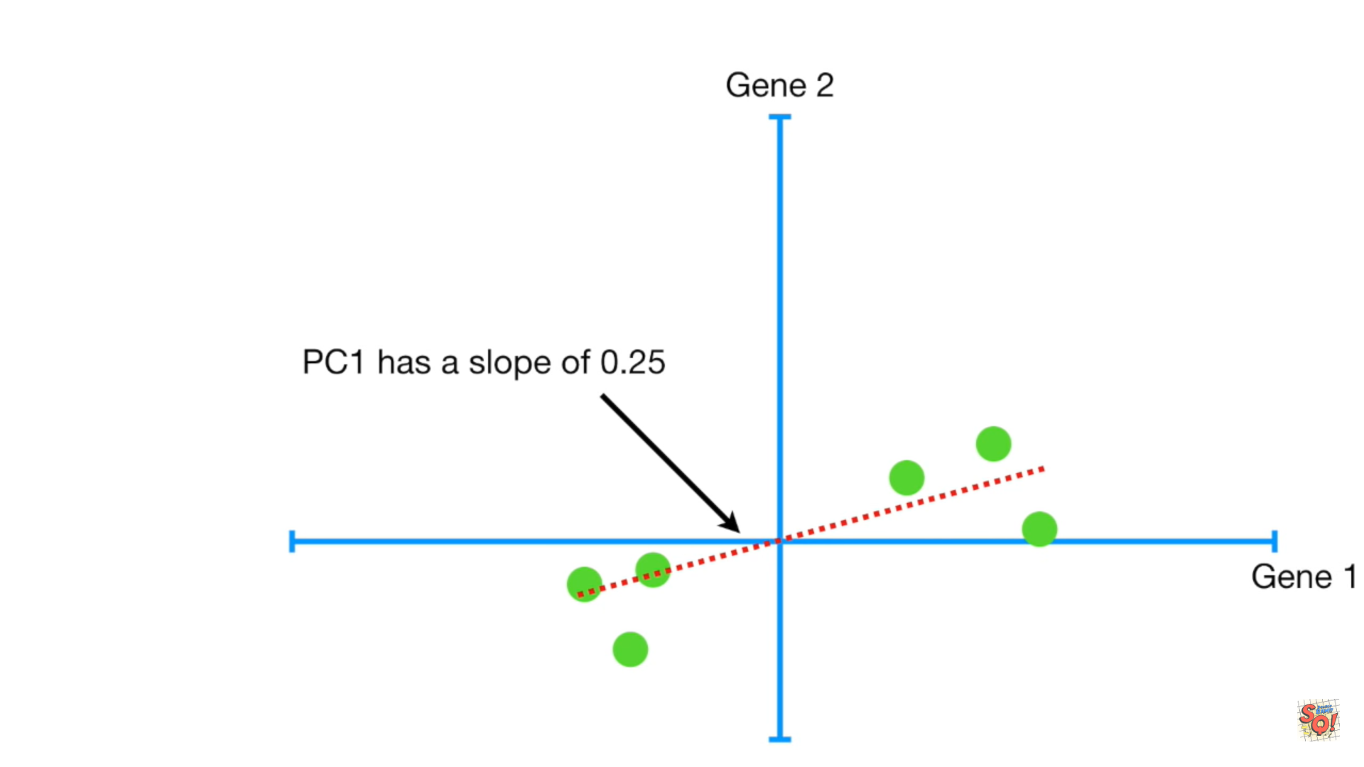

Slide 30
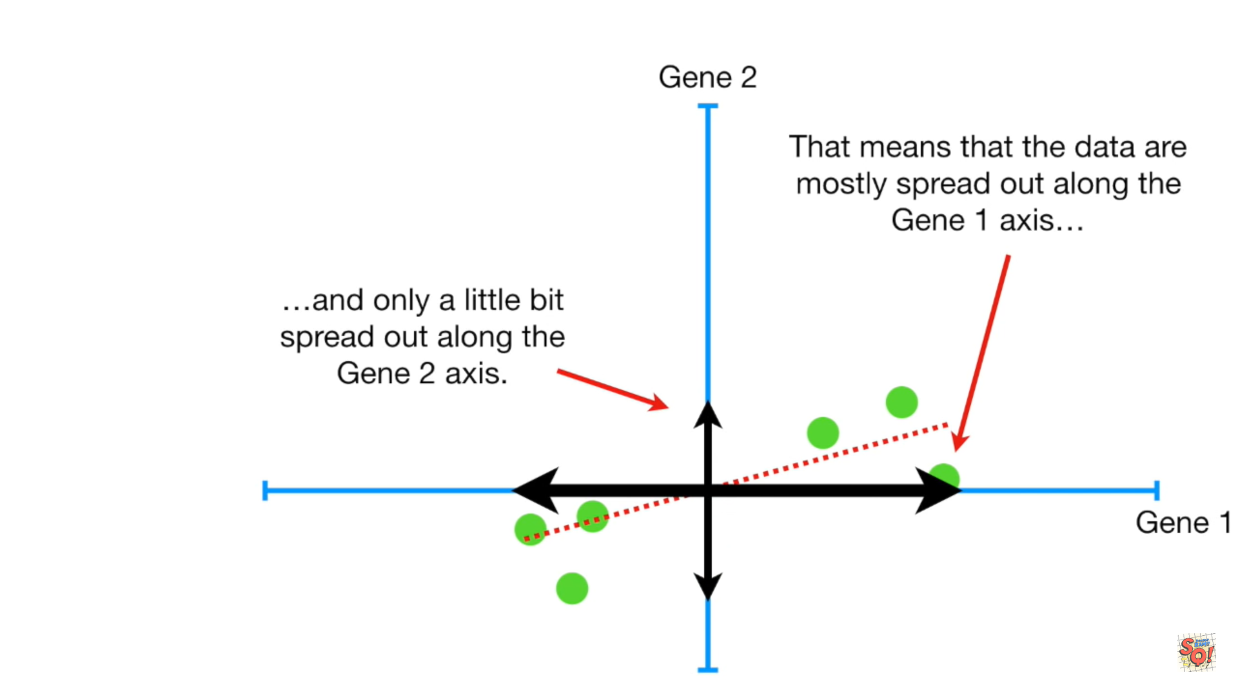

Slide 31
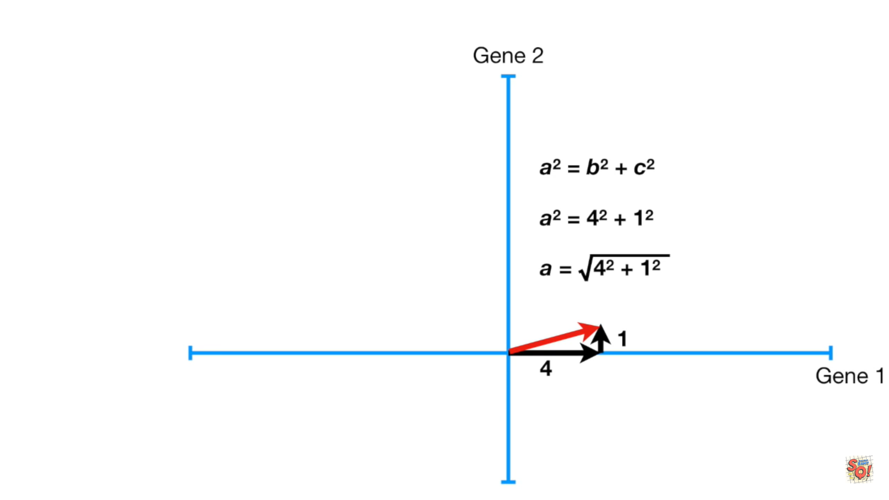

Slide 32
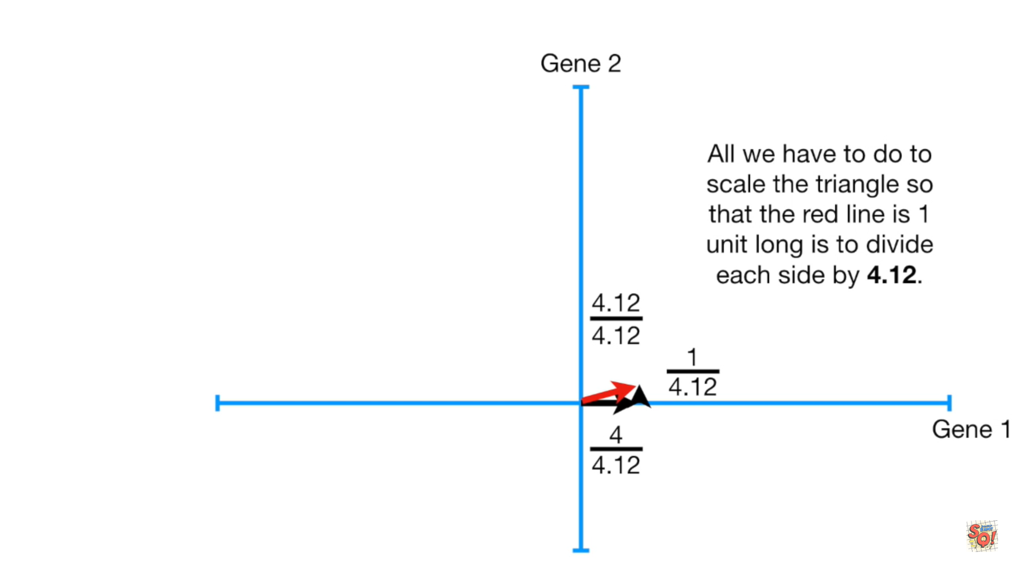

Slide 34
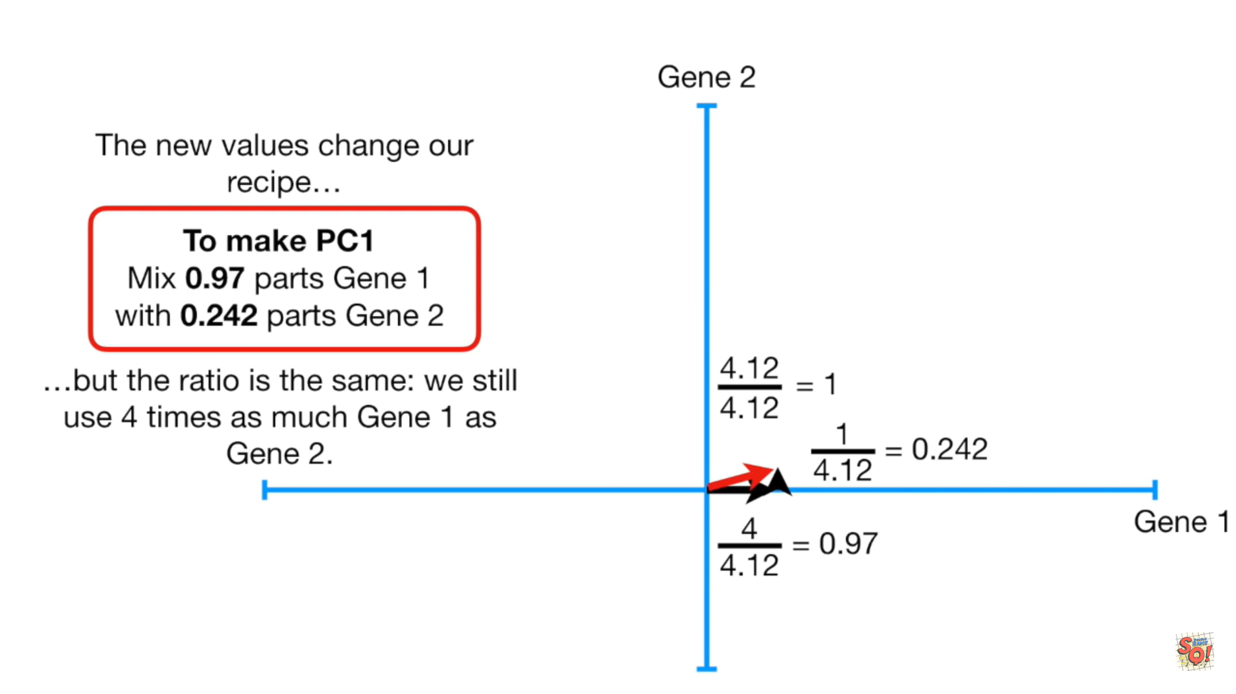

Slide 35
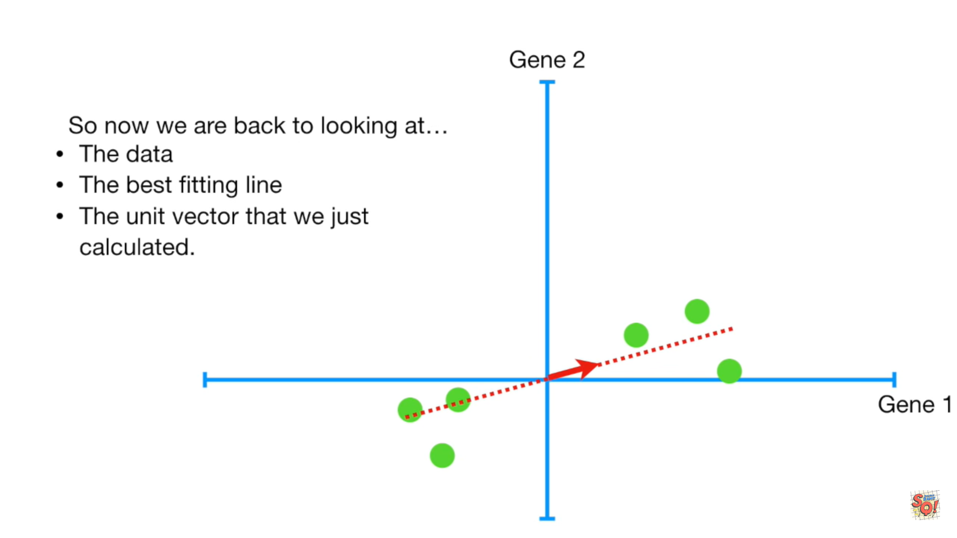

Slide 36
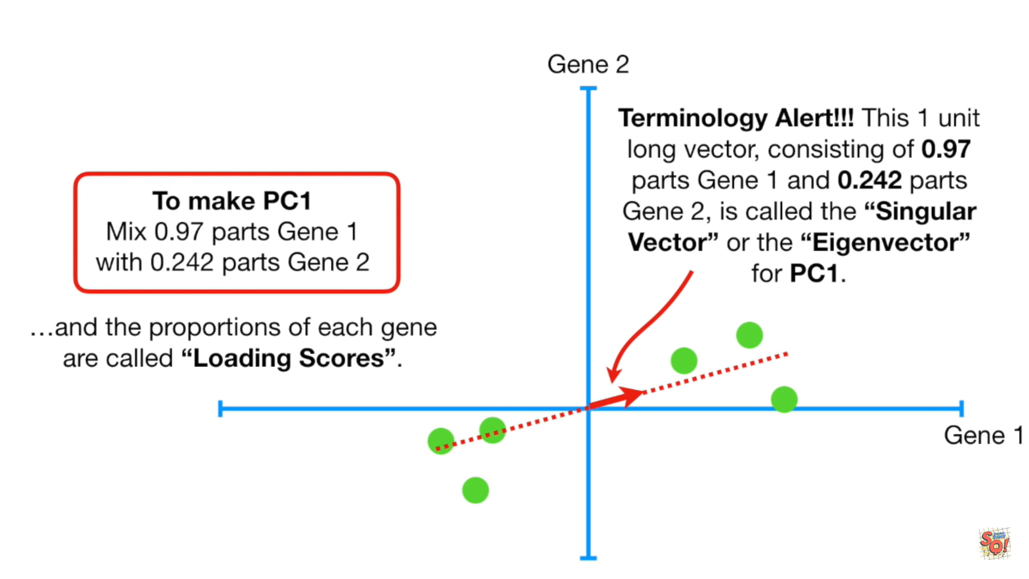

Slide 37
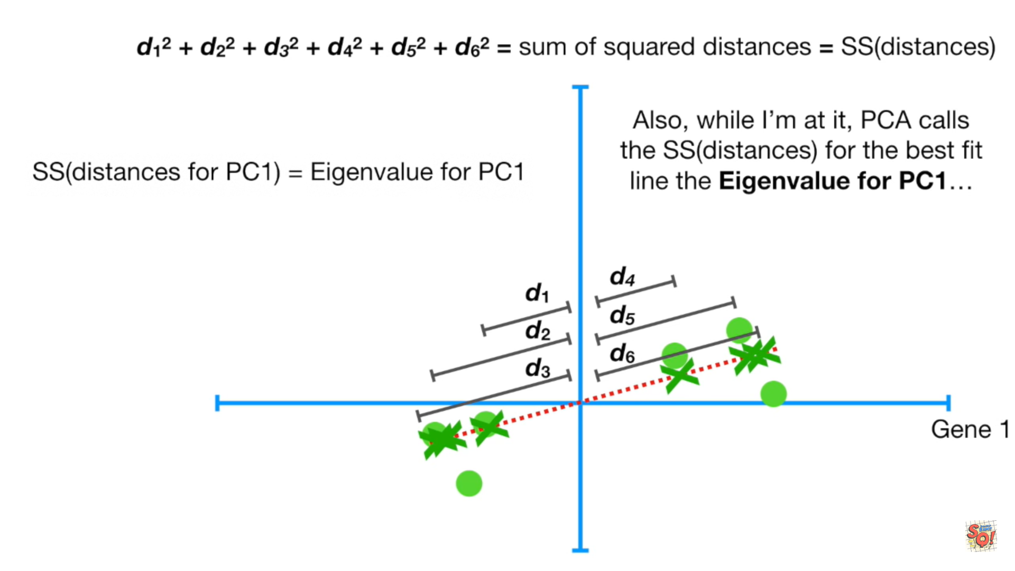

Slide 38
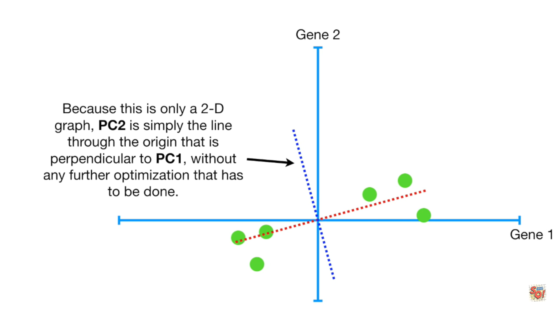

Slide 39
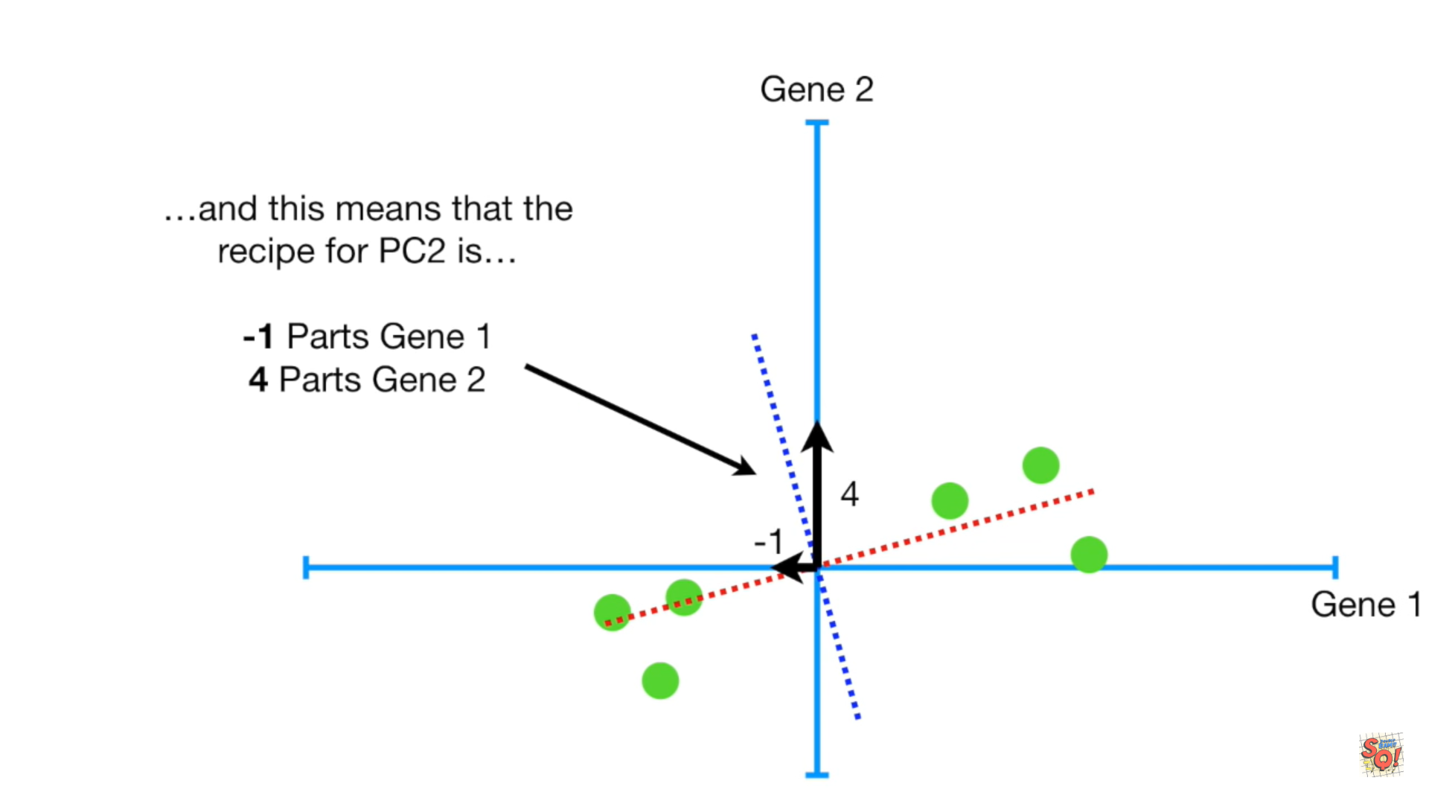

Slide 40
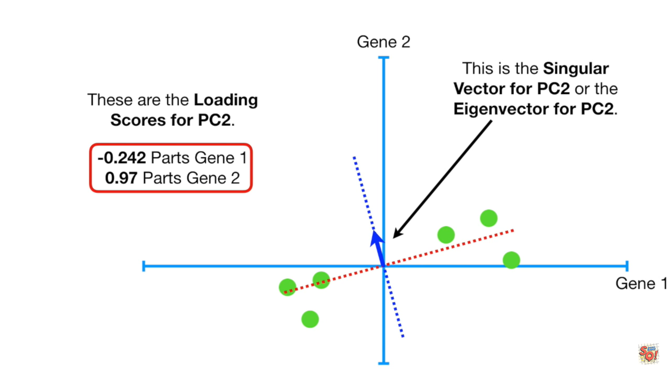

Slide 41
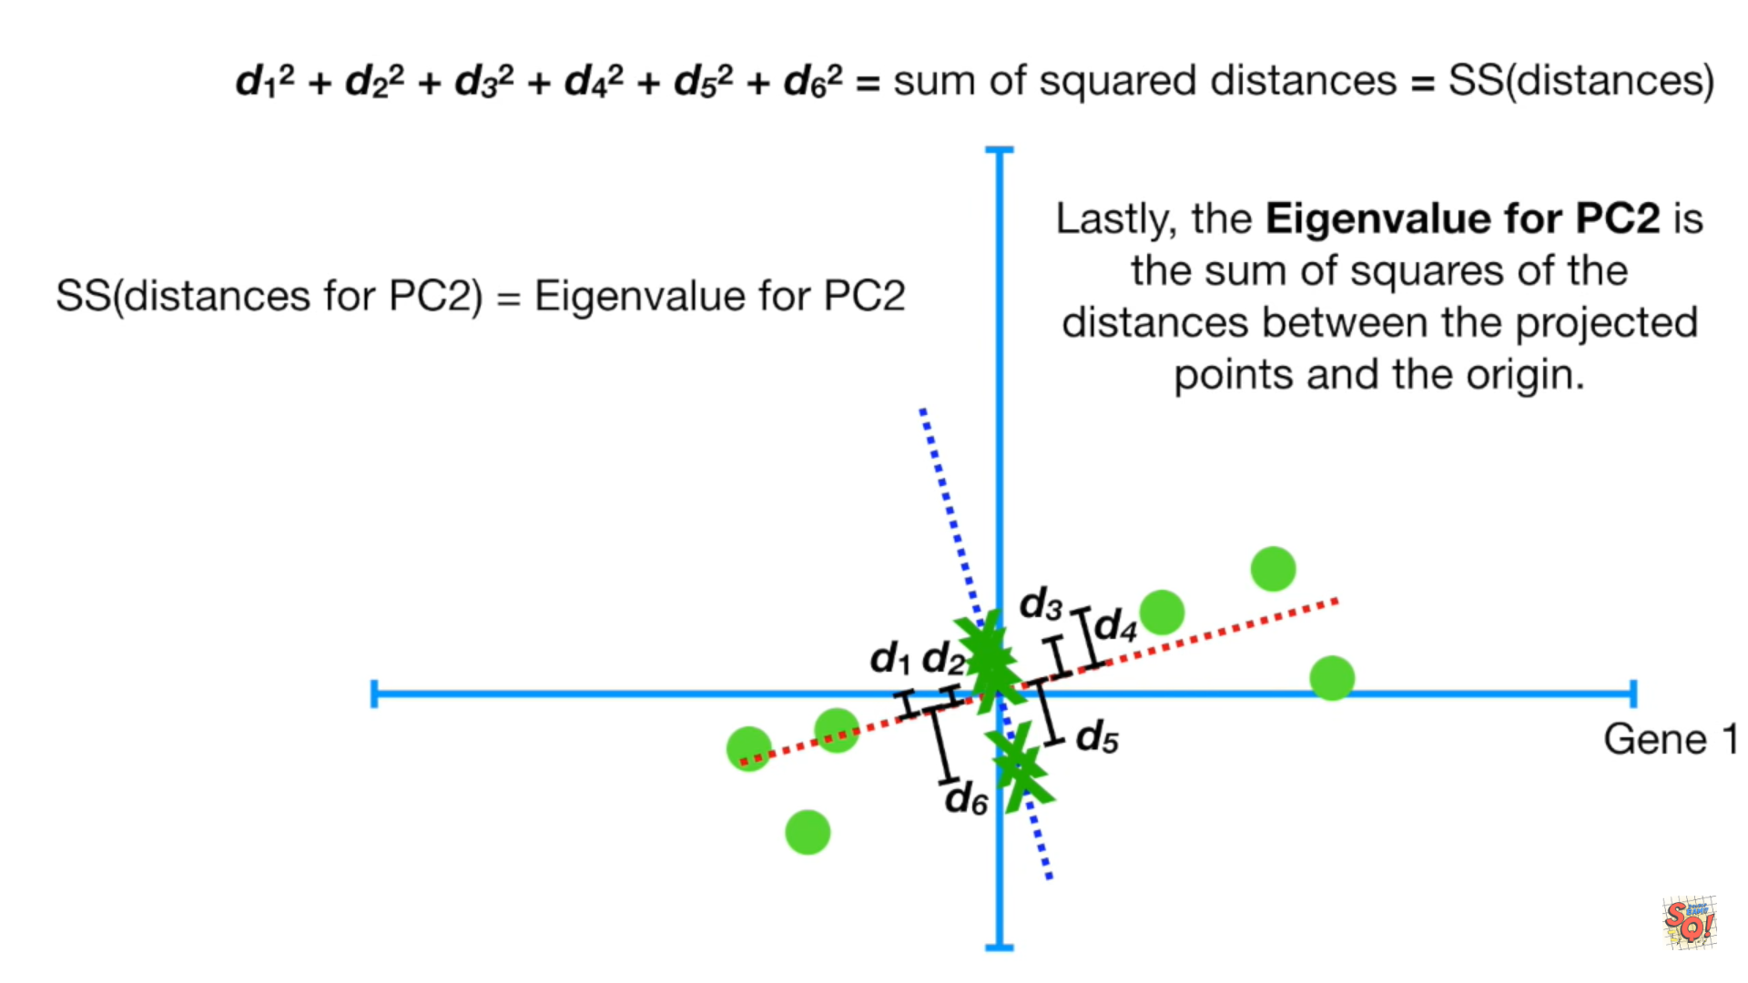

Slide 42
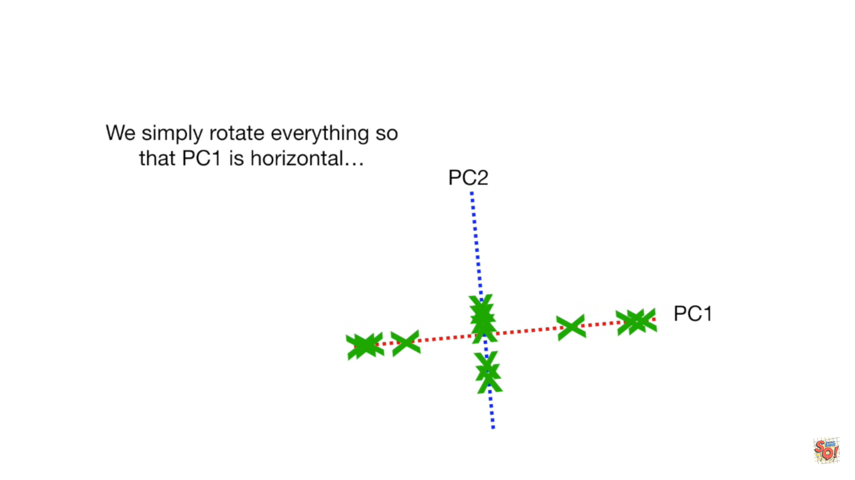

Slide 43
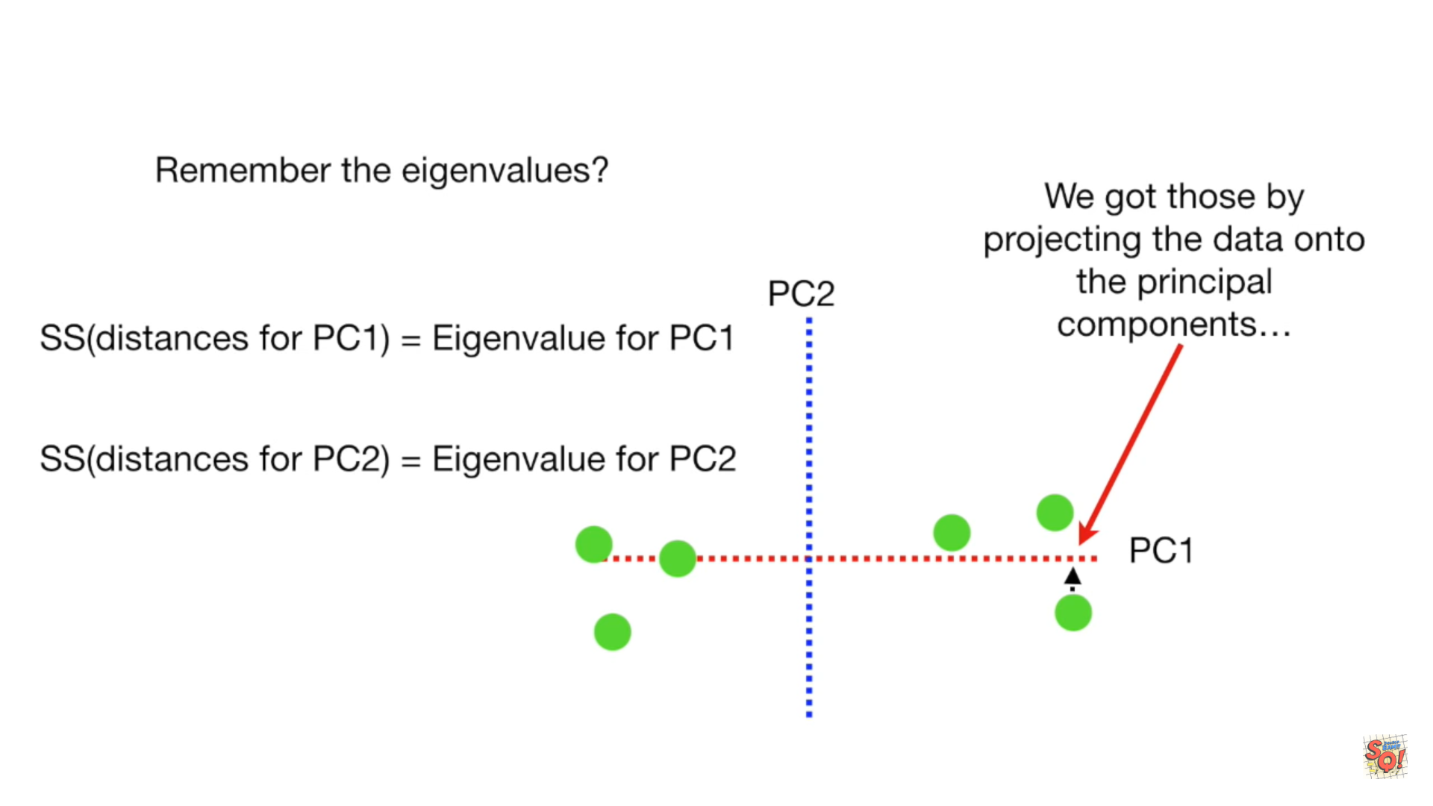

Slide 44
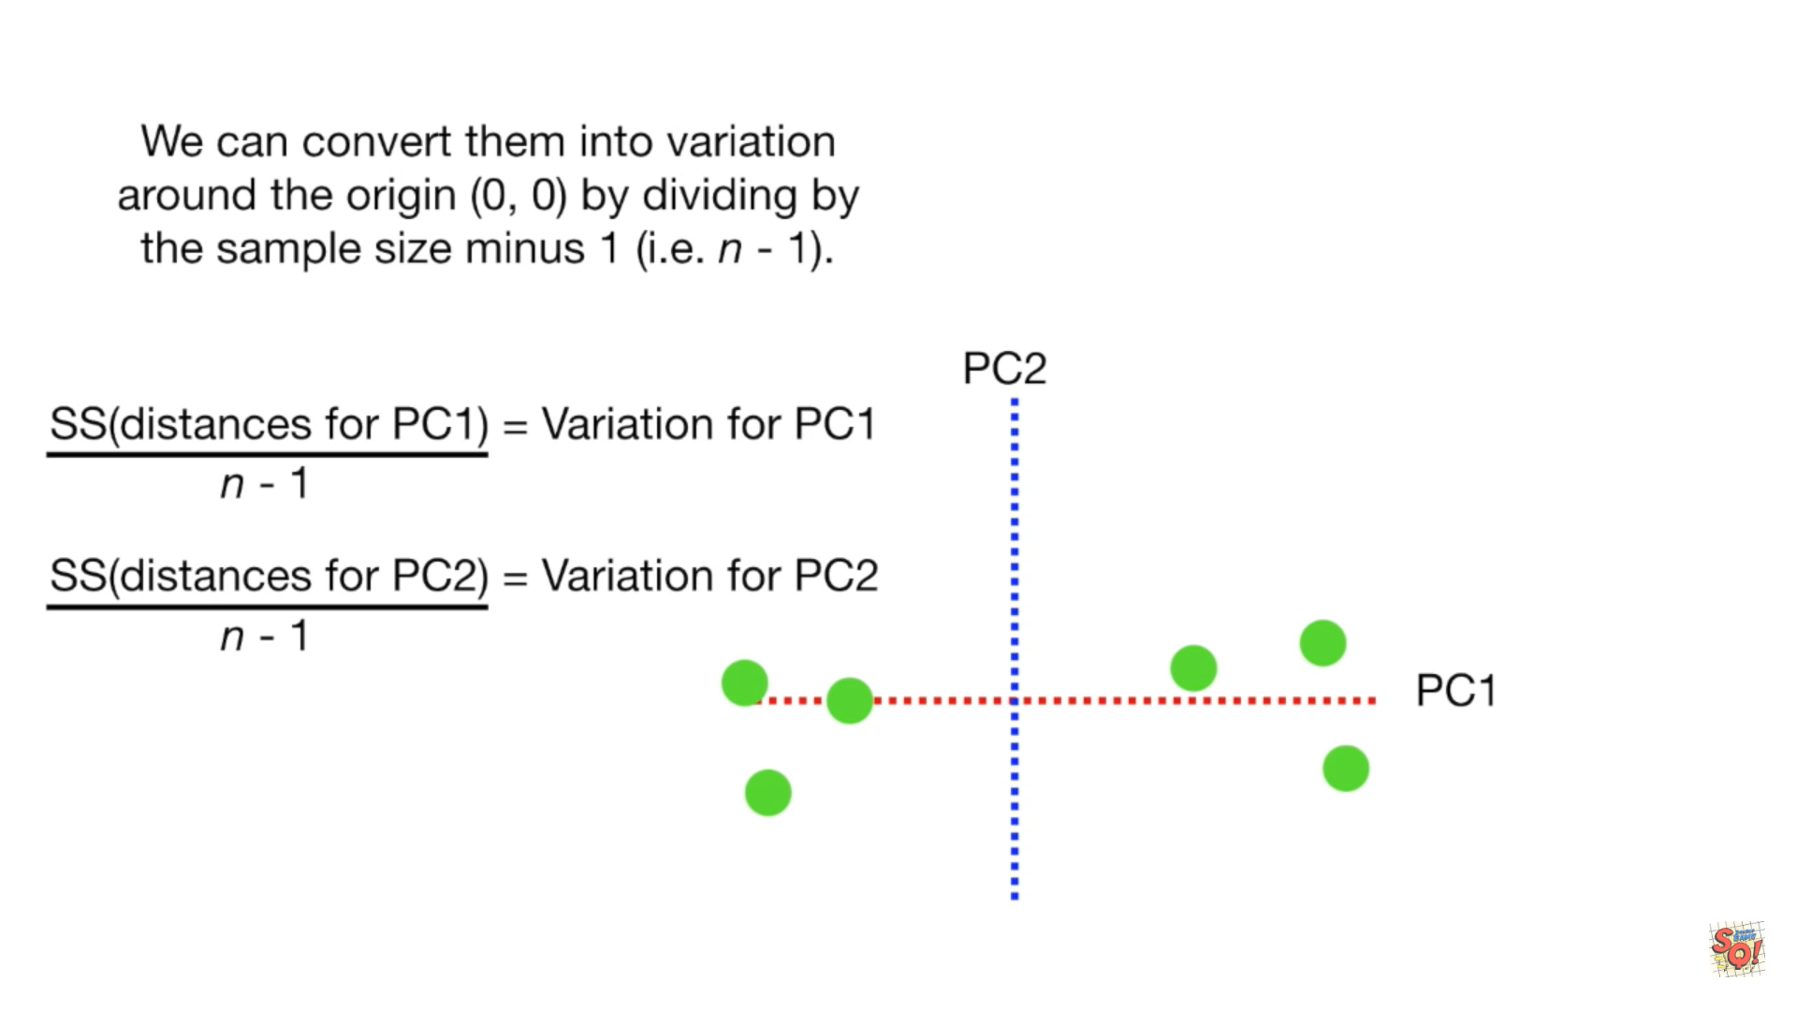

Slide 45
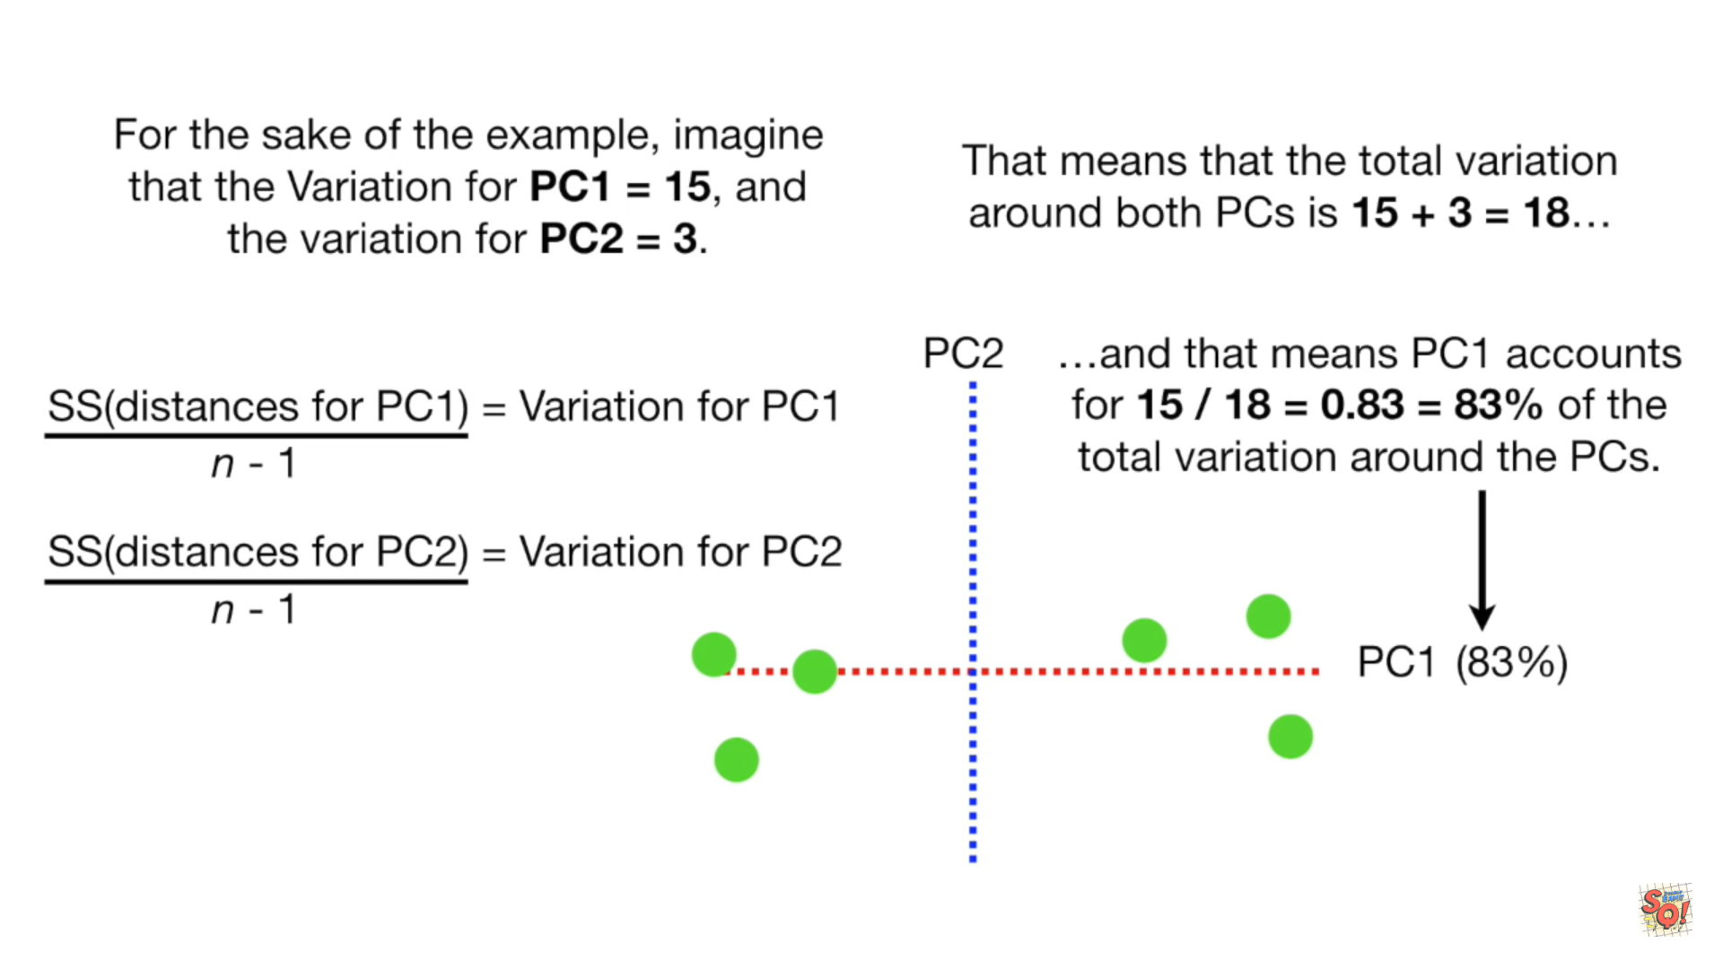

Slide 46
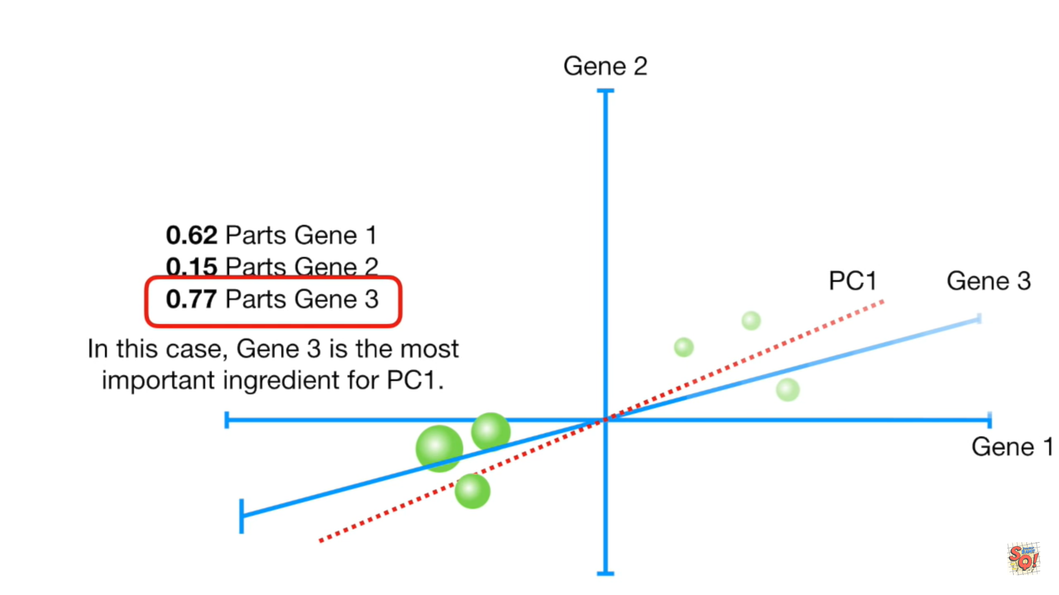

Slide 47
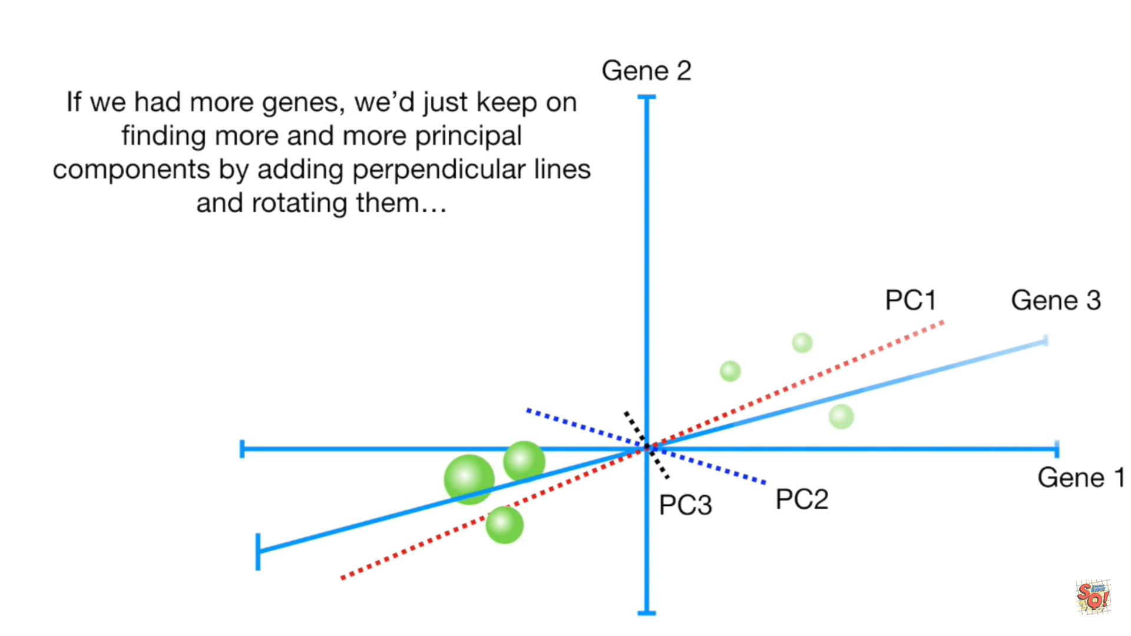

Slide 48
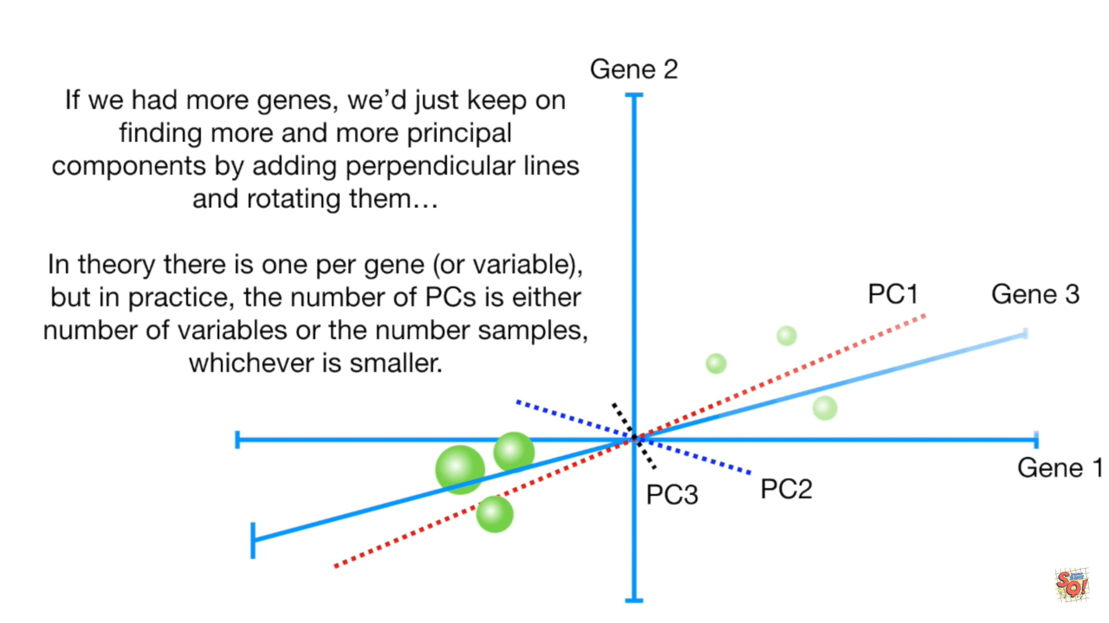

Slide 49
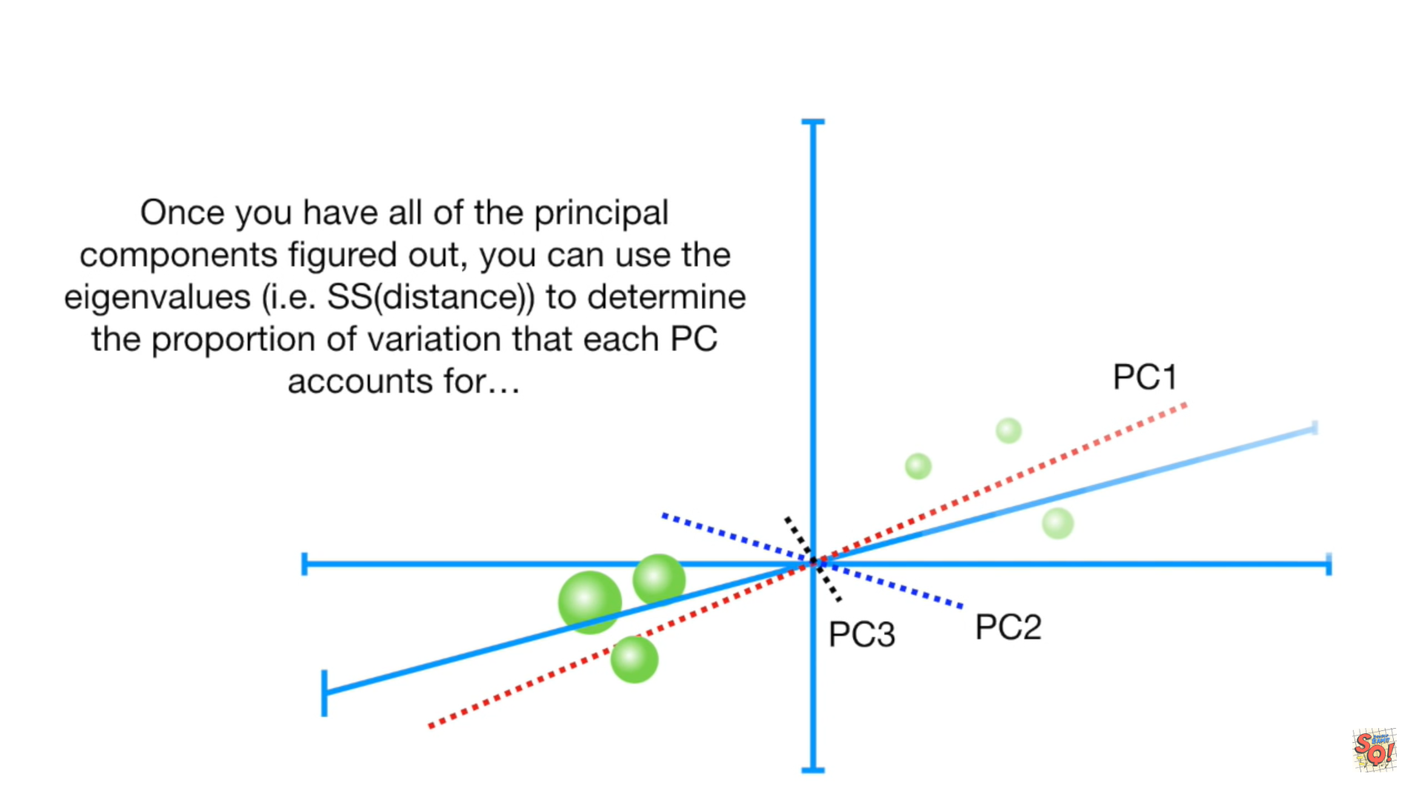

Slide 50
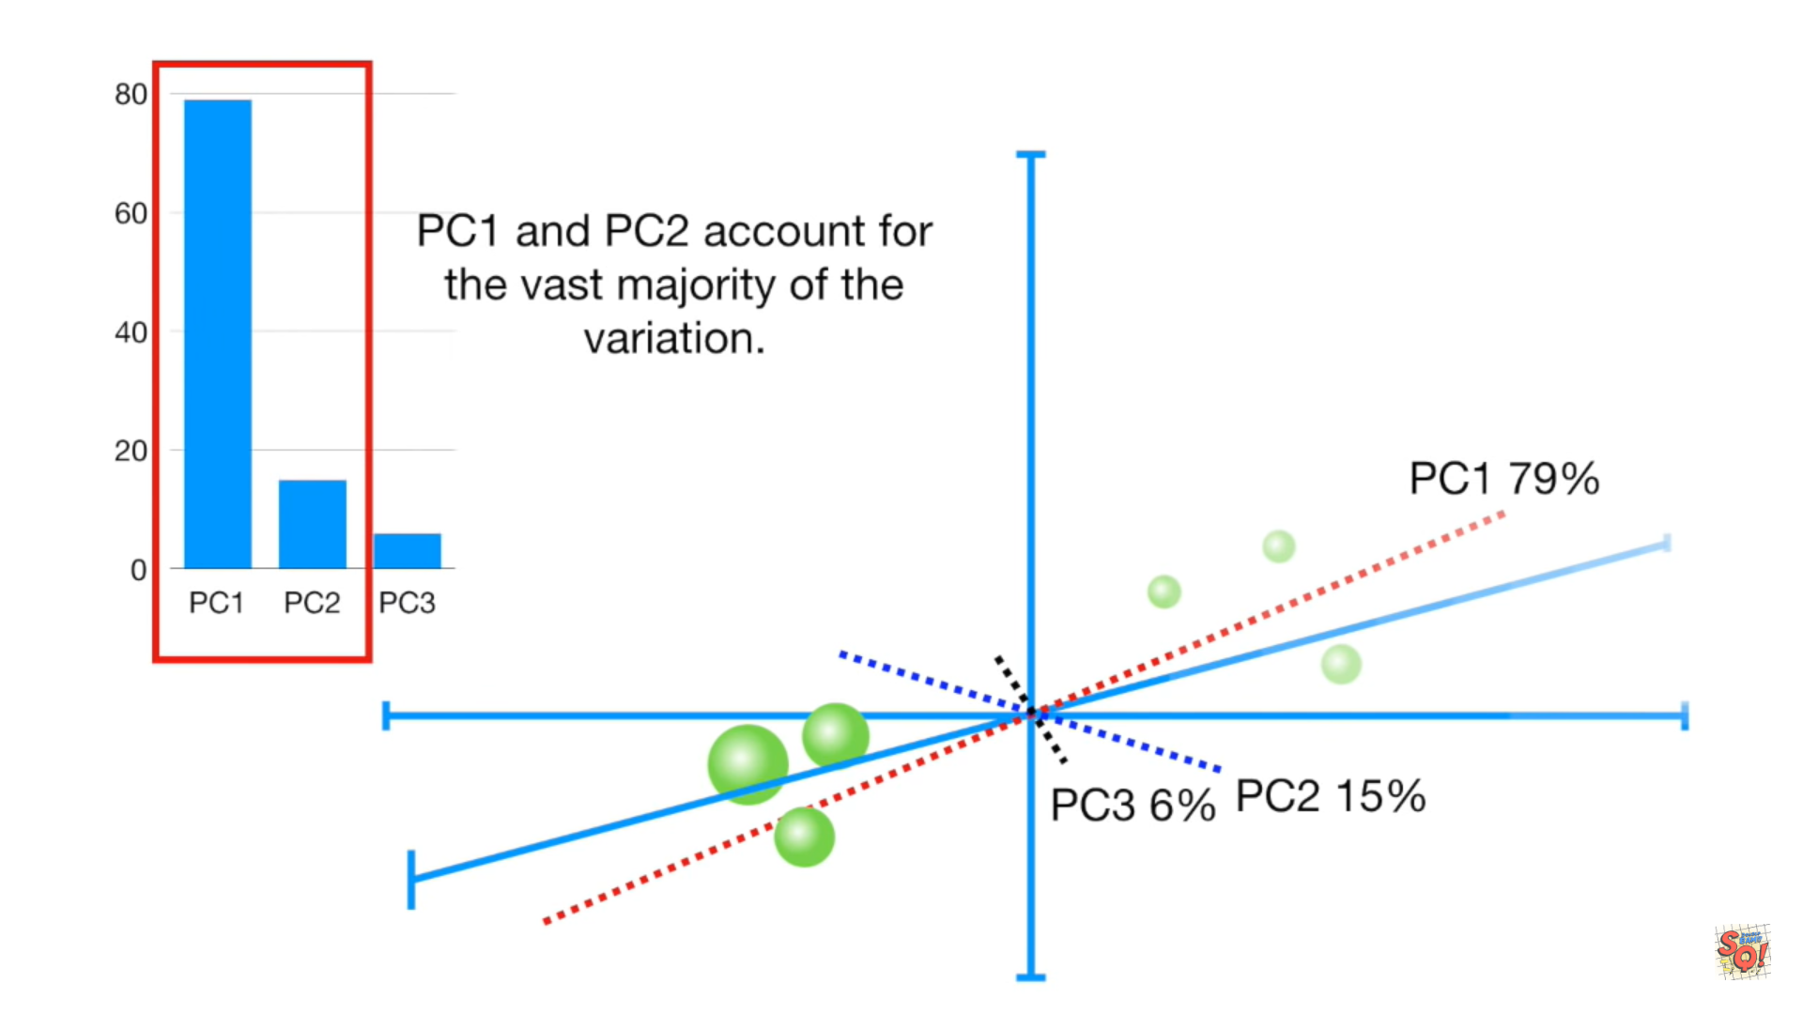

Slide 51
